Slide 1


Slide 2
Date:
November 13th, 2024
Presentation on:
Behavior Change Communication Journey Maps

Slide 3
In this session, we will develop a communication campaign together to address socio-cultural issues affecting our programmes.

Slide 4
Session Overview
You have been provided with an LCMT Toolkit, and a worksheet..
We will work in groups of to develop 2-3 communication messages to address the behavioral issue we have been working on..
Each group will address a particular behavioral issue.
The worksheets outlines 10-steps in developing a communication message. We will fill out the worksheets in our groups by designing communication messages by populating each step in the worksheet.
You can use the LCMT toolkit as a reference and learning tool to learn more about specific steps in the worksheets.

Slide 5


Problem Identification
What problem are we trying to solve?
What are the underlying causes of the problem?
Who are the key stakeholders?

Slide 6
2. Campaign Goal & Audience
What are the objectives of the campaign?
What will success of the campaign look like?

Slide 7
3. Target Audience and Communication Channels
Who is the target audience of the campaign?
What action do you want them to take/ what behavior do you want to change?
How can you reach this audience?

Slide 8
4. Message Development
Which message/s are most likely to achieve the objectives of the campaign?

Slide 9
5. Applying B.Science
Which emotions should our message evoke to be more impactful? (E.g. fear, hope, urgency, patriotism)
Can the message be framed positively or negatively to have more impact?
How can we time or place messages to coincide with moments when people are most likely to take action?
Is our message manipulating people in harmful ways?

Slide 10

Messaging strategies for behavior change
Message framing
Emphasize the benefits of a behavior rather than the risks of not engaging in it. For example, "Get vaccinated to protect yourself and your loved ones"
.
Emotional appeal
Emotional appeals can be powerful in motivating behavior change. Messages that evoke fear (e.g., health consequences of smoking) or empathy (e.g., the suffering of others) can inspire action.
Social Norms
Highlighting behaviors as socially desirable can be a very effective strategy. If people believe others are engaging in a behavior, they are more likely to follow suit.
Testimonials
Real-life stories and endorsements from trusted figures, such as community leaders, celebrities, or people who have successfully made a behavior change, can lend credibility and relatability to the message.
Personalization
Tailoring messages to specific segments of the target audience enhances relevance and effectiveness. Messages that speak directly to an individual’s lifestyle, values, and needs are more likely to resonate and drive action.
.
Clear call to action (CTA)
Clear and specific calls to action are essential for motivating individuals to take concrete steps.
Simplification
Behavioral change messages should be simple, easy to understand, and actionable. Overcomplicated or technical language can alienate the audience.
Incentives and rewards
Offering incentives, whether they are tangible (e.g., discounts or prizes) or intangible (e.g., recognition, social rewards), can drive behavior change.
Timing and frequency
The timing of a message matters. Similarly, frequency plays a key role in reinforcing behavior change, as people may need to hear a message multiple times before it leads to action.

Slide 11
6. Budget Considerations
What are the main cost categories for the campaign?
How much will each category cost?

Slide 12
7. Message Testing
Did you set aside a budget for testing? If no, Why?
Group feedback

Slide 13
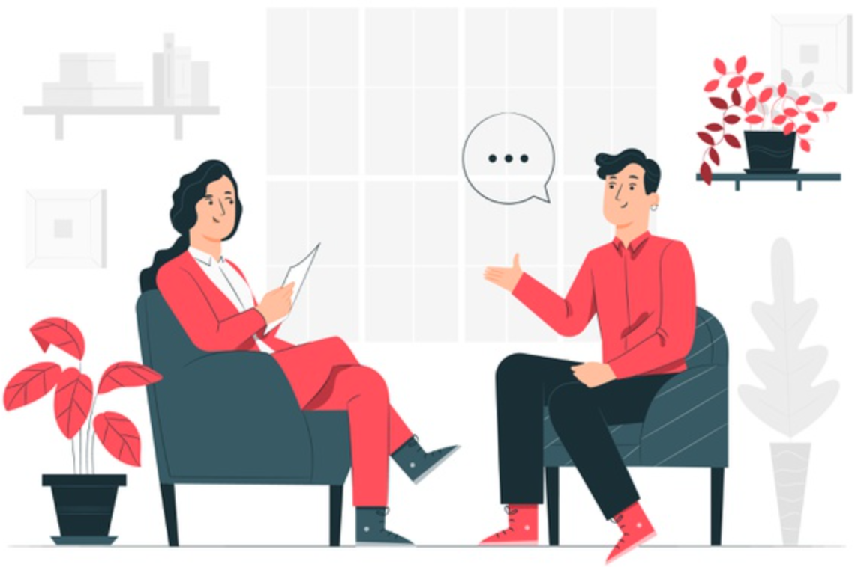
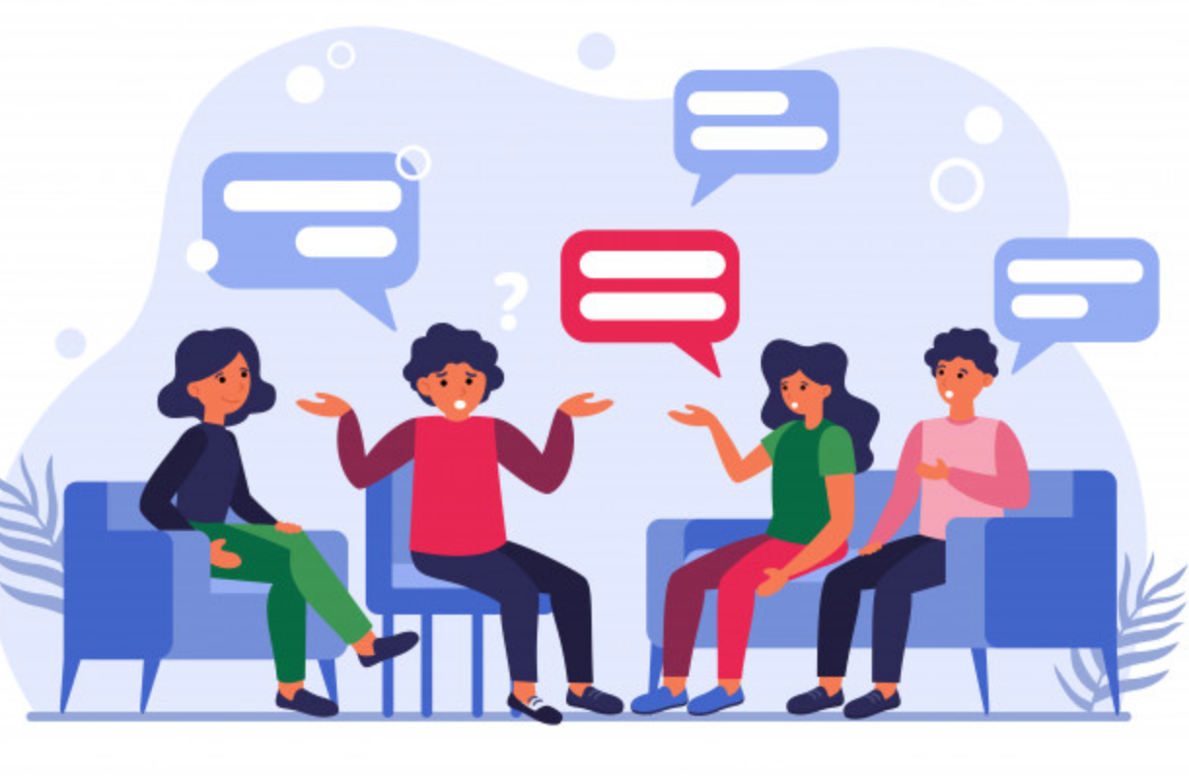
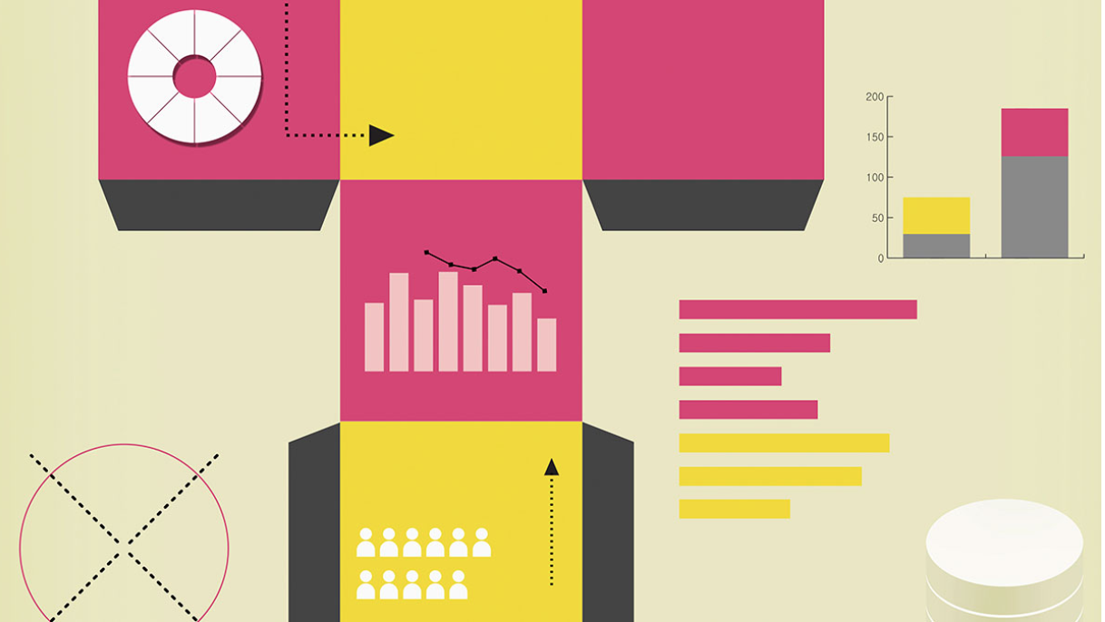

In-depth Interview
Focus Groups Discussions
Surveys
A/B Testing

Slide 14




Things to test for
Comprehension
Acceptance
Will the intended audience understand the message?
Is there anything about
the message that is offensive or inappropriate? Is this the right message for the audience?
Attractiveness
Believability
Does the message capture the attention of the intended audience?
Is the message believable and realistic to the intended audience?

Slide 15
Post-Testing Improvement
Based on the feedback received:
Is there anything that needs to be done to improve the message?
How can the feedback be incorporated into the messages?

Slide 16
Scaling
What does success look like at scale?
What actions can be taken to scale the campaign?
What channels/ tools will be used to scale?
What partnerships are needed to scale?

Slide 17
Review
What actions need to be taken to ensure the campaign continues to meet its objectives?
Who will be responsible for taking these actions?
How often do these actions need to be taken?
How will insights be used to improve the campaign?

Slide 18
3 Reflections
4 Next Steps
Learning in advocacy needs to happen earlier.
Incorporating behavioral insights can improve messages.
What other reflections do you have?
Share the messages you have developed.
Test the messages you have developed, scale them if they work!
Engage with the guide and give us feedback.
Let’s collaborate!

Slide 19
Thank you

