Slide 1


Slide 2
Date:
February 13th, 2025
Presentation on:
Qualitative Message Testing
Strengthening behavior change communication.

Slide 3



Contents
Qualitative Research
Re-Introduction to LCMT Guidebook
Crafting Qualitative Questions

Slide 4

Qualitative Testing
What it is, and what it isn’t

Slide 5
We use qualitative research to contextualize and understand a problem, decision making, behaviours, and perceptions.

Slide 6
Qualitative research aims to understand the context
Qualitative research looks for depth of responses and rich information.
Understanding WHO, WHAT, WHY and HOW matters.
Qualitative research is concerned with developing explanations of social phenomena by gathering in-depth understanding of human behavior and what governs that behavior.
Qualitative research aims to get a smaller sample that may represent sub-groups, experiences, and behavior.
Notes:
Critical categories emerge from research
Ongoing determination of sample
Research stops when ‘theoretical saturation’ occurs
Preference for non-probability sampling: “when you are collecting cultural data, as contrasted with data about individuals, then expert informants, not randomly selected respondents, are what you really need” (Bernard, 2011).

Slide 7
In the Assess phase of the AUDAS model, we are keen to use research to evaluate and improve our behavior change messages

Slide 8
Recommended Methods of Qualitative Testing
Rapid Prototyping: The process of building out early sample or version of your current messages and asking questions in order to refine and validate the concept or generate new concepts. This can be done using:
  In-Depth Interviews: Participants are encouraged and prompted by a researcher in a one-on-one interaction to talk in depth about your area of interest and messages
  Focus Group Discussions: Intentionally gathering a group of people together to have a semi-structured discussion about your area of interest and messages
This is NOT a one-time process. You should refine your message then do another round of rapid prototyping.
For example: Develop Message -> Test -> Iterate -> Test -> Iterate -> Test etc.

Slide 9
In-depth Interviews and Focus Group Discussions
IN-DEPTH INTERVIEWS
FOCUS GROUP DISCUSSIONS
Pros:
Obtain details that may not come out in a group setting
It is ideal for sensitive questions
It has reduced social desirability effect
Cons:
Time-consuming to interview a single person
Heavily subjective to individual’s experience
In person interviews are fairly expensive
Pros:
Time-efficient to interview many people
Provides a broader range of information
Better captures group/society thinking
Cons:
Risk of single dominant view being captured
Irrelevant diversion from the main topic
Social norms can influence participation of some groups.
Notes:
Most common form of qualitative research used here in Busara
These tend to be used concurrently and supplement each other in the early phase of a project
The extent of this is heavily dependent on budget constraints

Slide 10
Sampling Correctly is Important
You must clearly define your audience of interest, and sample respondents accordingly
In the first workshop, we identified areas of interest and key actors (eg: chiefs, herders, farmers, youth etc.). In our second workshop, we designed messages aimed at these audiences. Now, when testing these messages, we should aim to include all key actors in the surveys.
If we do not target them, we may fail to get accurate information. It doesn’t matter if I, sitting in Kenya, like and resonate with your message. It matters if community members in Lesotho do.

Slide 11
Re-Introducing LCMT
The Low Cost Messaging & Testing Guide

Slide 12
Busara has developed the Low Cost Message Testing Guidebook to support organizations enhance the effectiveness of communication campaigns and to engage effectively with the audiences and communities they serve.

Slide 13
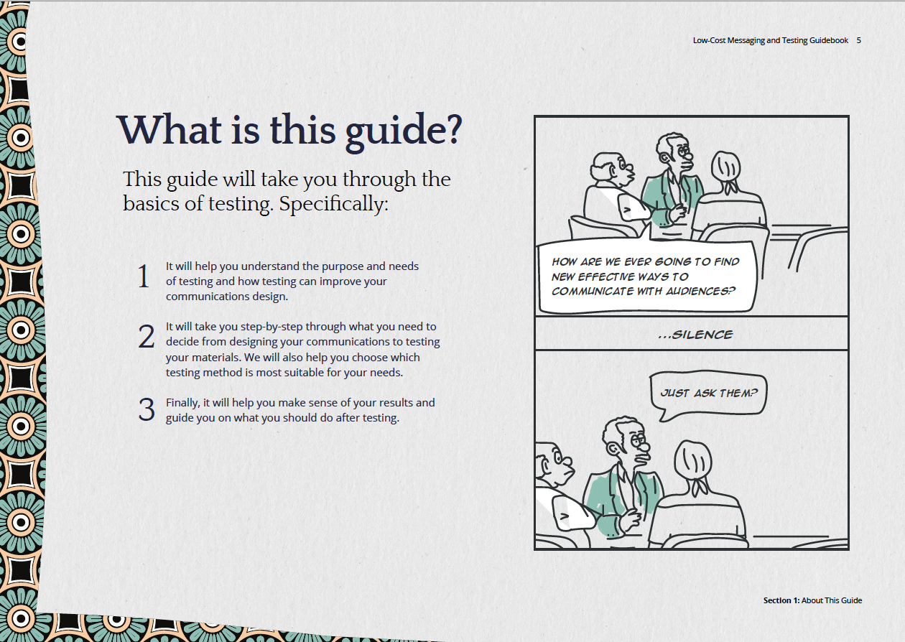
Notes:
The LCMT Guidebook is a resource for CSOs that outlines various mechanisms of testing communication campaigns before scaling them up.

Slide 14
The LCMT Guidebook is an open-resource developed to strengthen advocacy communication to achieve behavior change.
The guidebook works to:
Support organizations to streamline advocacy communication efforts by outlining the process of developing messages
Introduce testing and simplifies how qualitative and quantitative approaches can be used to test advocacy communications on a limited budget
Introduce organizations to behavioral science and how it can be integrated to advocacy communications to influence audience action.
Provide guidance on how to use testing data to enhance the messaging campaign before scaling

Slide 15
The LCMT Guidebook strengthens behavior change communication by:
Outlines the importance of message testing
Highlights the elements of a message that you can test
Demonstrates how behavioral science principles can be used to strengthen your message e.g simplification, personalization, framing
Describes qualitative and quantitative message testing methods i.e FGD and IDI process
Guides users on how to use the testing data to strengthen the messages
Outlines budget options for message testing

Slide 16




In-depth Interview
Focus Groups Discussions
Surveys
A/B Testing

Slide 17
Qualitative Research Process
Define research questions
Qualitative analysis
7
1
Identify target respondents
Implement and record the IDI/FGD in a safe place
6
2
5
3
Develop the interview guide with closed and open-ended questions
4
Recruit respondents
Train the facilitator/s and test the interview guide

Slide 18
Ways to use the LCMT Guidebook in your organization
Training of new hires | The guidebook can be instituted as part of the onboarding process for new hires in specific communications-related departments.
Refresher training | The content and techniques in the guidebook can be adopted for refresher trainings where necessary to help people to build on knowledge on effective advocacy communication.
Develop targeted training | Organizations can develop topic-specific training sessions on based on the different sections in the guidebook that are relevant in building the skills of different team members.
Promote peer learning | You can share this guidebook with other organizations in your network whom you think will benefit from such knowledge and tools.
Reference tool | Continue using on the Low-Cost Message Testing Guidebook as a reference and learning tool on developing effective messages. You can also visit the guidebook website: <messagetestingguide.busara.global>
Join our mailing list | We engage with our partners regularly to learn more about their work, disseminate knowledge on SBCC and behavioral science through our blogs and newsletters. Be part of our mailing list to access such information..

Slide 19
Creating Qualitative Surveys
What kind of questions should we ask?

Slide 20


Developing the instrument: Question content
Open ended
  Whenever possible, avoid close-ended questions (yes/no)
Funnel approach
  Start with broad questions, then narrow down answers using probes
  You can use a yes or no question, but make sure you probe after that
  Be prepared for your first open ended question to not yield much - this is what probes are for!
Use simple language
  We want to make this as easy for the participants as possible
Notes:
Including q’s and objectives means you can always refer back to them to ensure you are meeting goals, and you can explain what you want to the FOs so they can be better prepared for probes

Slide 21
Developing the instrument: Question content
Use language interviewees understand
Avoid leading questions
Make sure you ask open-ended questions that do not indicate possible responses.
Use ordinary conversational language in your interviews. Avoid jargon whenever possible.
Avoid double barrel questions
Focus on the experiences and knowledge of the interviewee
Avoid asking more questions in the same question. For example; Where do you get health information and how do you use it?
Word your questions to tap into the experience and knowledge of interviewees.
Notes:
e.g. What has been your experience being a black male in USA vs, what challenges do black men face in USA?

Slide 22
Leading questions
Cheat Sheet:
Patterns to avoid
Stacking questions
Be sure to avoid the following
Too many questions in a guide
Using technical terms/words
Unclear instructions to the enumerators
Subtitle here

Slide 23
Objectives of Qualitative Message Testing - Knowledge
You might want to understand what your intended audience already knows about your area of interest:
What information or misinformation might they already possess?
Where do they receive information from?
What sources of information do they trust? Which do they distrust?

Slide 24
Objectives of Qualitative Message Testing - Attitudes
You might want to understand what your intended audience feels about your area of interest:
What do they care about? Why?
Do they prioritize your intended behavior? To what extent?

Slide 25
Objectives of Qualitative Message Testing - Preferences
One of your aims could be to find out the preferences held by the person you are interviewing. These preferences can serve as a proxy for actual behaviour.
This could be done by directly asking participants which option they prefer:
You need to clear an area to plant crops and graze. How would you clear the field?
or by providing them with options they can rank:
Rank the following methods of clearing a field: Burning, Sustainable Clearing etc.
or, if you suspect they have a reason to lie, you could use revealed preference measures
Would you sign this public petition to stop farmers/herders from burning the rangeland?

Slide 26
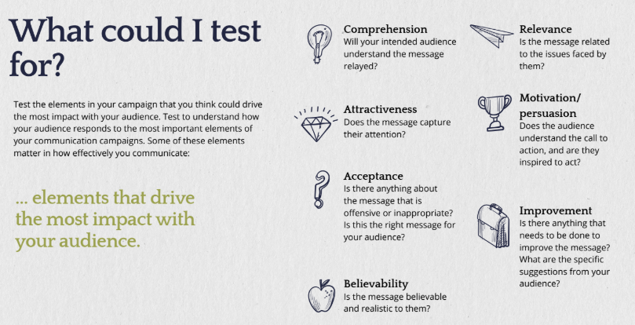
Elements of Qualitative Message Testing

Slide 27
Objectives of Qualitative Message Testing - Probes
Probes are follow up questions you would ask based on a respondent’s answer. Your aim is to encourage the respondent to expand on their answers and give as many details as possible.
Examples:
Tell me more about…
When you said ______ what did you mean by that?
How so?
Can you describe _____ more?
Why?

Slide 28
“A little testing is better than no testing.”

Slide 29
Thank you

