Slide 1


Slide 2
Date:
February 14th, 2025
Presentation on:
Analyzing Qualitative Data
Translating Data to Insights and Iteration

Slide 3


Contents
Qualitative Data Analysis
Iterating on Messages

Slide 4

Qualitative Data Analysis
How do we go from data to insights?

Slide 5
Reminder:
We are using qualitative research to learn from the community, understand the context, and improve our behaviour change communications

Slide 6



Myths about Data Analysis

Slide 7
Qualitative Data Analysis
Data
Open-ended responses (data) we collect

Slide 8
Qualitative Data Analysis
Data
Insights
Open-ended responses (data) we collect
Actionable conclusions drawn from the data that explain respondents’ behaviour, barriers, levers, knowledge, motivations etc.

Slide 9
Qualitative Data Analysis
Data
Insights
Iteration
Open-ended responses (data) we collect
Actionable conclusions drawn from the data that explain respondents’ behaviour, barriers, levers, knowledge, motivations etc.
Improving our behavior change messages

Slide 10
Qualitative Data Analysis - Data Stripping
Data Stripping Sheets: A simple template to extract & organize key data from interviews or focus groups. Ensures:
Consistency - Standardizes data extraction procedures
Efficiency - Condense large amounts of text into key insights
Collaboration - Easy for team members to present, review, and validate findings

Slide 11
Qualitative Data Analysis - Data Stripping Procedure
Step 1: Put the questions from your survey into a row of an excel spreadsheet
 | Question 1 | Question 2 | Question 3 | Question 4 | Question 5

Slide 12
Qualitative Data Analysis - Data Stripping Procedure
Step 2: Populate the spreadsheet with your responses
Respondent ID | Question 1 | Question 2 | Question 3 | Question 4 | Question 5
Survey 1 | Cat | Yes | No | Mother | Maize
Survey 2 | Fish | I agree | Never | Father | Beans
Survey 3 | Dog | That is true | Not even once | Sister | Peas

Slide 13
Qualitative Data Analysis - Data Stripping Procedure
Step 3: Identify patterns
Respondent ID | Question 1 | Question 2 | Question 3 | Question 4 | Question 5
Survey 1 | Cat | Yes | No | Mother | Maize
Survey 2 | Fish | I agree | Never | Father | Beans
Survey 3 | Dog | That is true | Not even once | Sister | Peas
 | Animals | Agreement | Disagreement | Family | Food

Slide 14
Qualitative Data Analysis - Data Stripping
Task:
A data stripping sheet has been collected for the data you collected yesterday.
We will spend time today working with the stripped data to analyze and improve our slogans.

Slide 15
Qualitative Data Analysis - Developing Codebooks
Codebooks: A system for labeling data with clear definitions to help you organize your data. They are especially useful when you have large amounts of qualitative data.
Procedure:
Familiarize yourself with the data: Read through a few responses to understand recurring ideas and patterns.
Generate Codes: Identify common themes, concepts, or topics mentioned in the data. These can be per-question or survey-wide. Use simple, descriptive names for these themes (e.g., "Benefits of Environment”, “Danger of Burning Rangeland”, "Lack of Trust" etc.)
Group Codes into Categories: Organize related codes into broader categories (e.g., "Behavioural Barriers", "Consequences of Climate Change" etc.).
Apply Codes: Go through the data, applying codes to each response to each question.
Then, you can refer back to a code to see all responses that fit the theme and analyze data easily!

Slide 16
Qualitative Data Analysis - Thematic Analysis
Thematic Analysis: A systematic process of identifying, analyzing, and interpreting patterns (themes) in qualitative data.
You are looking for key insights (actionable conclusions drawn from data) to help you in your objectives
Procedure:
Look at each Category of Codes, read through the relevant coded responses, and look for patterns. These could be similarities OR differences in responses
eg: many respondents might mention that they cut trees for use in cooking; half mention they litter while half say they do not litter)
Now, look at the responses that differ. What are they saying that is different? How might this be useful to us? (eg: a handful of respondents mention they cut trees because they enjoy the process of cutting trees - it makes them feel macho and manly)
Look to your demographics to contextualize the patterns you found - Is a particular group saying similar things (eg: young men say they like cutting trees because it makes them feel strong)
Use the identified patterns to generate insights - actionable conclusions you can apply

Slide 17
Let’s Analyze the Data Together
Today, since we have relatively few responses to each survey, we will be skipping the coding step.
Instead, we will directly begin thematically analyzing the data.
In the stripped data handouts, we have included 2 additional columns separate to the questions and responses.
The first asks us to find and identify common patterns and key takeaways (similarities, differences, interesting responses etc,)
The second asks us to translate these into key insights: What do the findings mean for our messages?

Slide 18
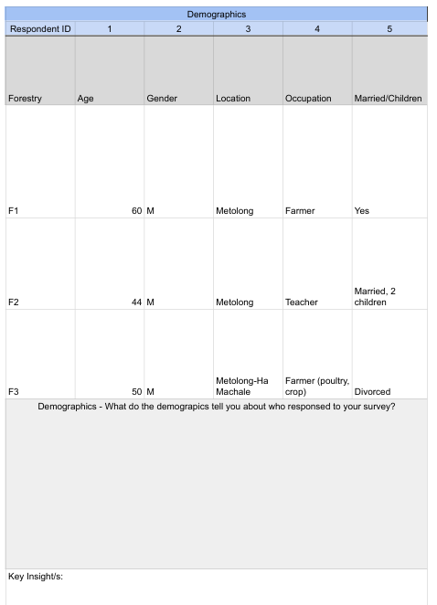
Follow Along -
Identify Patterns

Slide 19
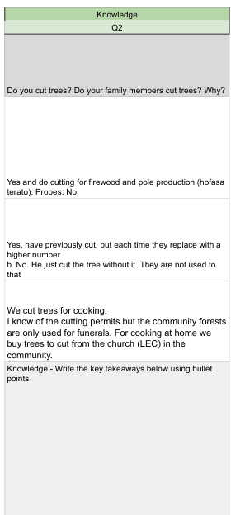
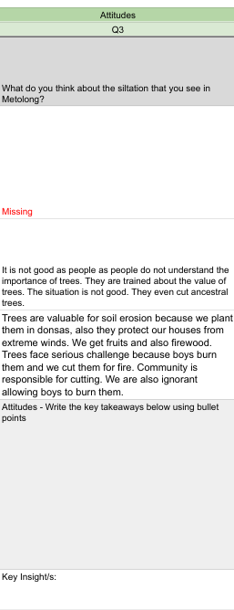
Follow Along -
Identify Patterns

Slide 20
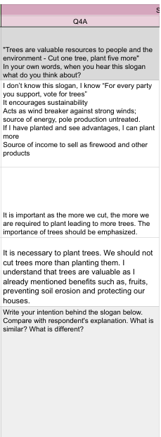
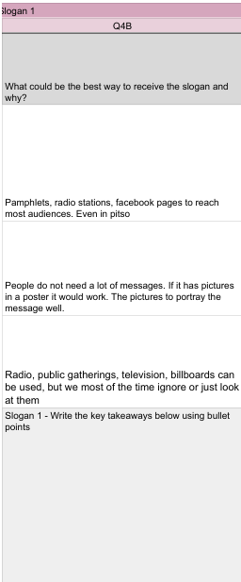
Follow Along -
Identify Patterns

Slide 21
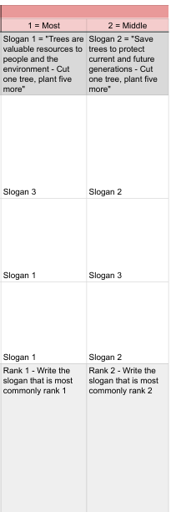
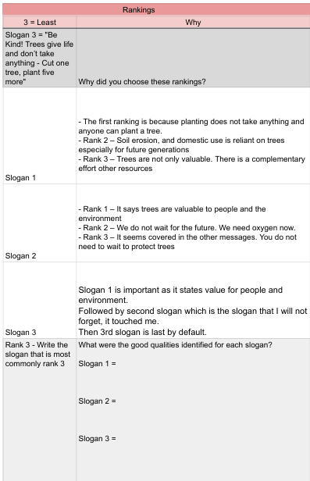
Follow Along -
Identify Patterns

Slide 22
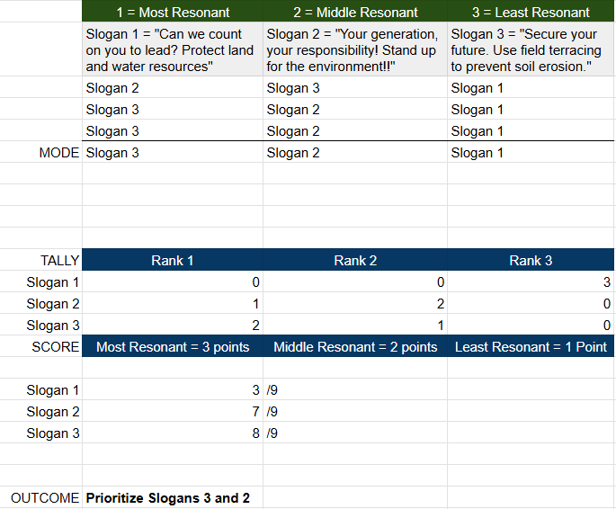
Using the
Tally + Score Method

Slide 23
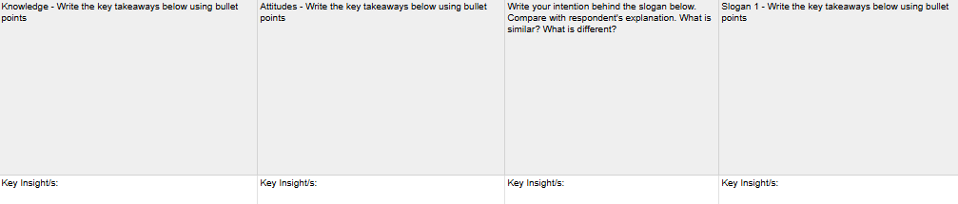
Follow Along - Apply Key Insights
So What?
So What?
So What?
So What?

Slide 24
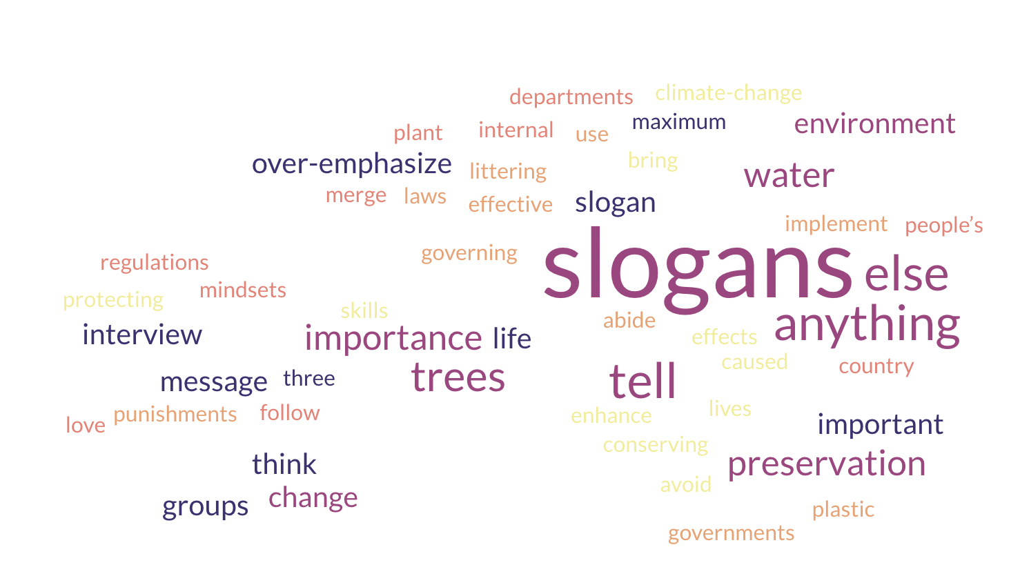
Other ways of analysing qualitative data - Word Clouds
Is there anything else you would like to tell us about the slogans?

Slide 25
Other ways of analysing qualitative data - Direct Quotes
Qualitative data is rich and includes respondent’s feelings, emotions, thoughts, and ideas. Apart from analyzing the data and drawing out actionable insights, we can also find direct quotes that are powerful, impactful, and emotional.
These quotes can be used as support for a certain conclusion, or to evoke emotion in someone you are presenting your research findings too.
" I hope and wish all of us would take water preservation seriously. It is essential for us, the flora and fauna. It is life itself”
Male, 50-60, Metolong

Slide 26
Iterating On Messages
How do we translate insights to revisions of messages?

Slide 27
Prioritizing Messages
Which messages did participants prefer? Why?
How did participants engage with your message? Is it the way you intended?
Which messages are most strategically aligned to your objectives?
Which messages are most relevant for your audience?
Which messages were the clearest and simplest?

Slide 28
Revising Messages
Can the messages more closely align with your objectives?
Can your messages be made simpler and clearer?
Can the call to action be better?
Were there any misunderstandings from your messages?
Does your message convey the desired emotions? (e.g. urgency, hope, empowerment etc.)

Slide 29
Test, Test, and Test Again
Audience preferences evolve.
External factors change, which can affect your intervention.
Adapt to emerging trends.
Keep iterating to optimize engagement and effectiveness of calls to action.
Keep innovating to avoid message fatigue
Identifying new opportunities.

Slide 30
Thank you

