Slide 1


Slide 2
Date:
November 11th, 2024
Presentation on:
Messaging Interventions for Behavior Change
The role of messaging interventions in driving behavior change

Slide 3


Contents
Session objectives
Background to SBCC
Role of communication interventions in behavior change
Messaging strategies to influence behavior change
Tailoring communication to specific audiences
Q&A
Group reflection
Notes:
Social and Behavior Change Communication

Slide 4
Communication is central to the work government and private sector actors do.
Communication messaging is often used to:
Advance policy and change
Mobilize action
Raise awareness and shape opinions
Build support (Donors, volunteers, partners etc)
Raise awareness
Influence public opinion
Organizations often have the burden of developing and disseminating quality and effective communication to influence attitudes, perceptions and behavior of their intended audience.

Slide 5
Common barriers to effective organizational communication
In most cases, established and grassroot organizations are unable to engage with their target audience effectively because:
They do not know/understand their target audience (behavior, attitudes and knowledge etc)
Develop the same communication message for all audiences
Do not test the messages before scaling
Ineffective communication can lead to confusion among the audience as the call to action (CTA) will be unclear. People will not know what to do or how to act.
If the message is not clearly articulated, it may fail to generate the intended impact or drive meaningful action.

Slide 6
Communication interventions are critical in shaping behaviors by disseminating information, promoting positive actions, and altering attitudes and perceptions.
Effective communication can lead to measurable changes in behaviors, particularly when combined with behavioral science principles, such as social norms, motivation, and cognitive biases.
These interventions can take many forms, including mass media campaigns, public service announcements, digital content, educational programs, and community-based outreach programs.

Slide 7
The role of communication interventions in behavior change
Raising awareness
Shifting attitudes
Communication interventions help individuals and communities become aware of issues or behaviors they may not have previously considered.
Effective messaging can alter public perceptions and attitudes toward a behavior or issue.
Influencing social norms
Mobilize action
Communication campaigns can shape what is perceived as "normal" behavior within a community.
Communication interventions offer clear, credible information that allows individuals to make informed decisions.
Notes:
E.g campaigns that portray environmental sustainability as a social norm can influence people’s attitudes about waste reduction, recycling, and eco-friendly practices.

Slide 8
To drive behavior change through communication, messages must be carefully crafted based on the target audience’s characteristics, needs, and perceptions.

Slide 9

Messaging strategies for behavior change
Message framing
Emphasize the benefits of a behavior rather than the risks of not engaging in it. For example, "Get vaccinated to protect yourself and your loved ones"
.
Emotional appeal
Emotional appeals can be powerful in motivating behavior change. Messages that evoke fear (e.g., health consequences of smoking) or empathy (e.g., the suffering of others) can inspire action.
Social Norms
Highlighting behaviors as socially desirable can be a very effective strategy. If people believe others are engaging in a behavior, they are more likely to follow suit.
Testimonials
Real-life stories and endorsements from trusted figures, such as community leaders, celebrities, or people who have successfully made a behavior change, can lend credibility and relatability to the message.
Personalization
Tailoring messages to specific segments of the target audience enhances relevance and effectiveness. Messages that speak directly to an individual’s lifestyle, values, and needs are more likely to resonate and drive action.
.
Clear call to action (CTA)
Clear and specific calls to action are essential for motivating individuals to take concrete steps.
Simplification
Behavioral change messages should be simple, easy to understand, and actionable. Overcomplicated or technical language can alienate the audience.
Incentives and rewards
Offering incentives, whether they are tangible (e.g., discounts or prizes) or intangible (e.g., recognition, social rewards), can drive behavior change.
Timing and frequency
The timing of a message matters. Similarly, frequency plays a key role in reinforcing behavior change, as people may need to hear a message multiple times before it leads to action.

Slide 10
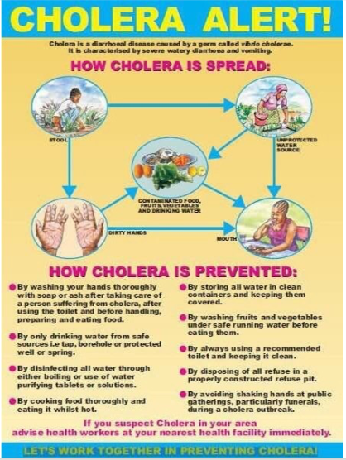
When information is not simple, easy or relevant, people take longer to understand and more likely to make errors
Standard Health Messaging:

Slide 11
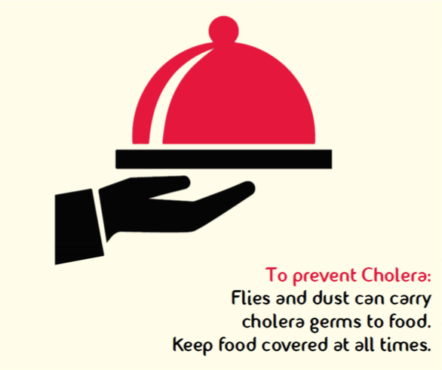
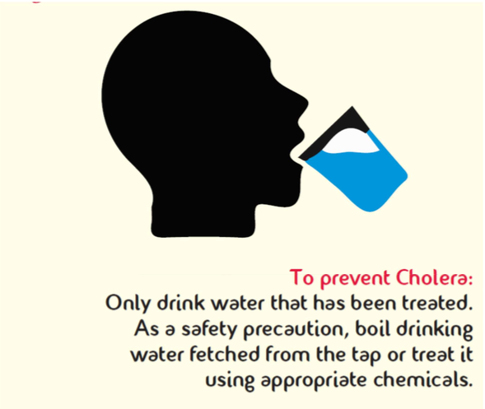
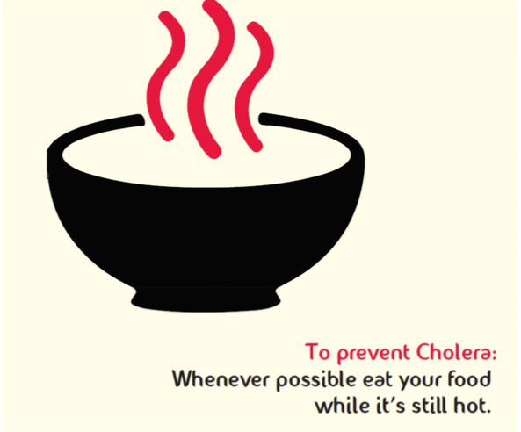
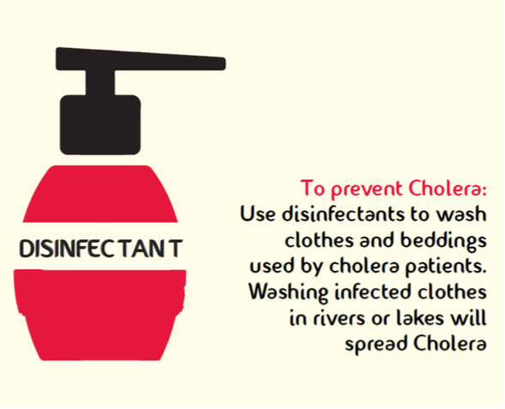
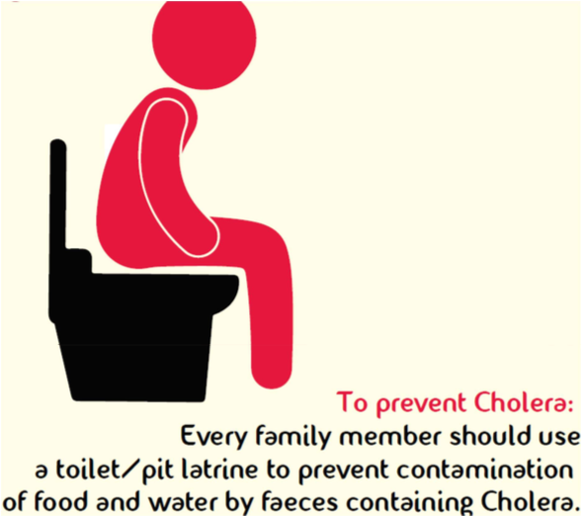
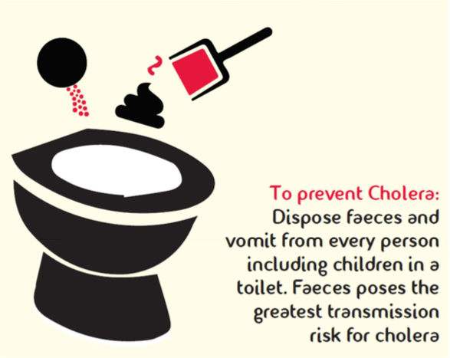
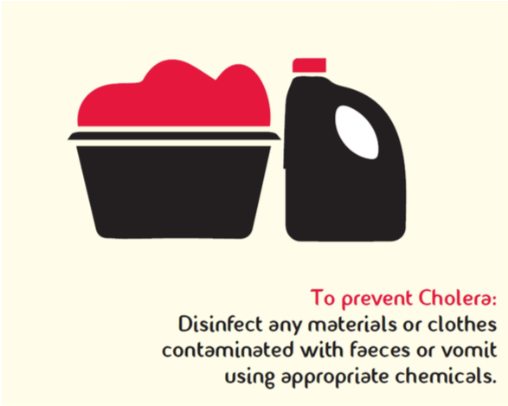


When information is not simple, easy or relevant, people take longer to understand and more likely to make errors
Standard Health Messaging:
Making the message simpler, easier and relevant:

Slide 12
Tailoring messaging to different audiences: Demographics
Demographic factors
Consider age, gender, income, and education level. Younger audiences may respond well to digital platforms and social media, while older adults may prefer radio.
Psychographic factors
Understand the values, attitudes, and lifestyles of the target group. Environmental campaigns may resonate more with people who already have an interest in sustainability.
Behavioral Factors
Segmenting audiences based on their readiness for change allows for more tailored interventions.

Slide 13
Tailoring messaging to different audiences:Psychographics
Demographic factors
Consider age, gender, income, and education level. Younger audiences may respond well to digital platforms and social media, while older adults may prefer radio.
.
Psychographic factors
Understand the values, attitudes, and lifestyles of the target group. Environmental campaigns may resonate more with people who already have an interest in sustainability.
a
Behavioral Factors
Segmenting audiences based on their readiness for change allows for more tailored interventions.

Slide 14
Tailoring messaging to different audiences:Behavior
Demographic factors
Consider age, gender, income, and education level. Younger audiences may respond well to digital platforms and social media, while older adults may prefer radio.
Psychographic factors
Understand the values, attitudes, and lifestyles of the target group. Environmental campaigns may resonate more with people who already have an interest in sustainability.
Behavioral Factors
Segmenting audiences based on their readiness for change allows for more tailored interventions.

Slide 15
Group Reflection Exercise (15 Mins)
In your organization
Referring to the previously shared messaging strategies for behavior change, please pick one and write a communication change message for RSDA
  Which strategies do you think you can adapt to enhance communication

Slide 16
Messaging strategies for behavior change
Message framing
Emphasize the benefits of a behavior rather than the risks of not engaging in it. For example, "Get vaccinated to protect yourself and your loved ones"
.
Emotional appeal
Emotional appeals can be powerful in motivating behavior change. Messages that evoke fear (e.g., health consequences of smoking) or empathy (e.g., the suffering of others) can inspire action.
Social Norms
Highlighting behaviors as socially desirable can be a very effective strategy. If people believe others are engaging in a behavior, they are more likely to follow suit.
Testimonials
Real-life stories and endorsements from trusted figures, such as community leaders, celebrities, or people who have successfully made a behavior change, can lend credibility and relatability to the message.
Personalization
Tailoring messages to specific segments of the target audience enhances relevance and effectiveness. Messages that speak directly to an individual’s lifestyle, values, and needs are more likely to resonate and drive action.
.
Clear call to action (CTA)
Clear and specific calls to action are essential for motivating individuals to take concrete steps.
Simplification
Behavioral change messages should be simple, easy to understand, and actionable. Overcomplicated or technical language can alienate the audience.
Incentives and rewards
Offering incentives, whether they are tangible (e.g., discounts or prizes) or intangible (e.g., recognition, social rewards), can drive behavior change.
Timing and frequency
The timing of a message matters. Similarly, frequency plays a key role in reinforcing behavior change, as people may need to hear a message multiple times before it leads to action.

Slide 17
Thank you

