Slide 1


Slide 2
Date:
November 13th, 2024
Presentation on:
The Low-Cost Message Testing Guidebook (LCMT)
What it is and its role in strengthening behavior change communication.

Slide 3
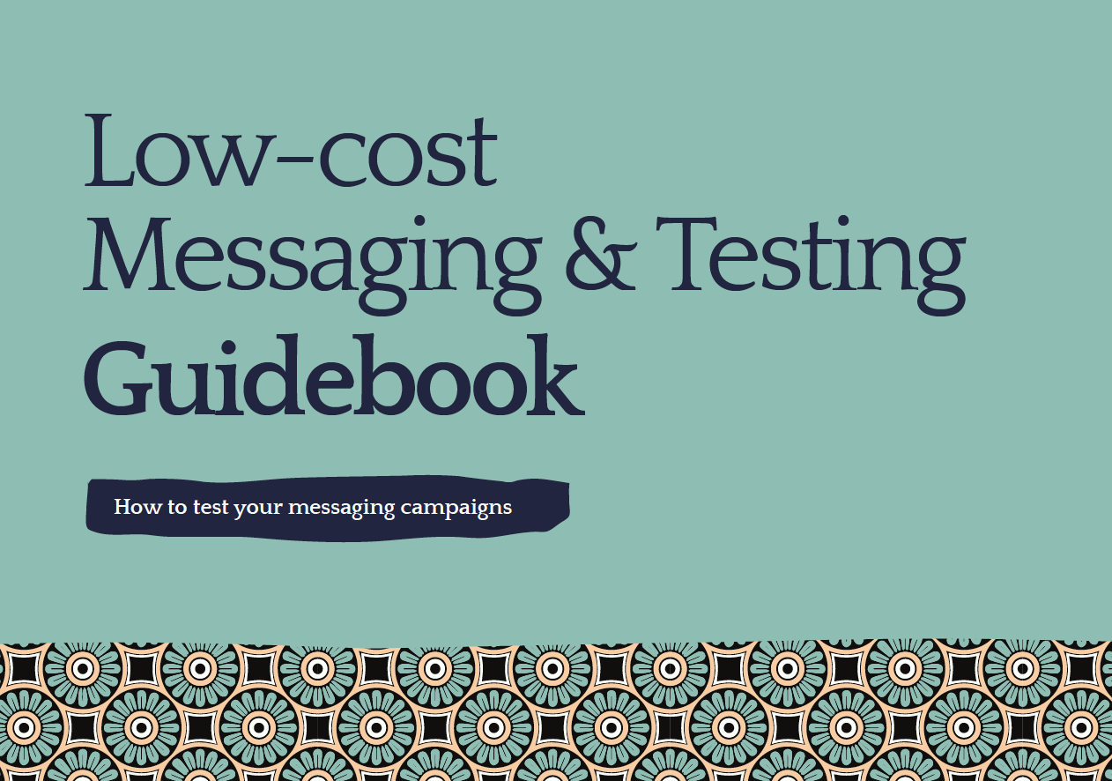


Contents
Background to SBCC
Introduction to LCMT Guidebook
User experience of the guidebook
LCMT in capacity-strengthening
Using the guidebook

Slide 4
Communication is central to the work government, private sector actors and CSO do.
Communication messaging is often used to:
Advance policy and change
Mobilize action
Raise awareness and shape opinions
Build support (Donors, volunteers, partners etc)
Raise awareness
Influence public opinion
Organizations often have the burden of developing and disseminating quality and effective communication to influence attitudes, perceptions and behavior of their intended audience.

Slide 5
Common barriers to effective organizational communication
In most cases, established and grassroot organizations are unable to engage with their target audience effectively because:
They do not know/understand their target audience (behavior, attitudes and knowledge etc)
Develop the same communication message for all audiences
Do not test the messages before scaling
Ineffective communication can lead to confusion among the audience as the call to action (CTA) will be unclear. People will not know what to do or how to act.
If the message is not clearly articulated, it may fail to generate the intended impact or drive meaningful action.

Slide 6
Busara has developed the Low Cost Message Testing Guidebook to support organizations enhance the effectiveness of communication campaigns and to engage effectively with the audiences and communities they serve.

Slide 7
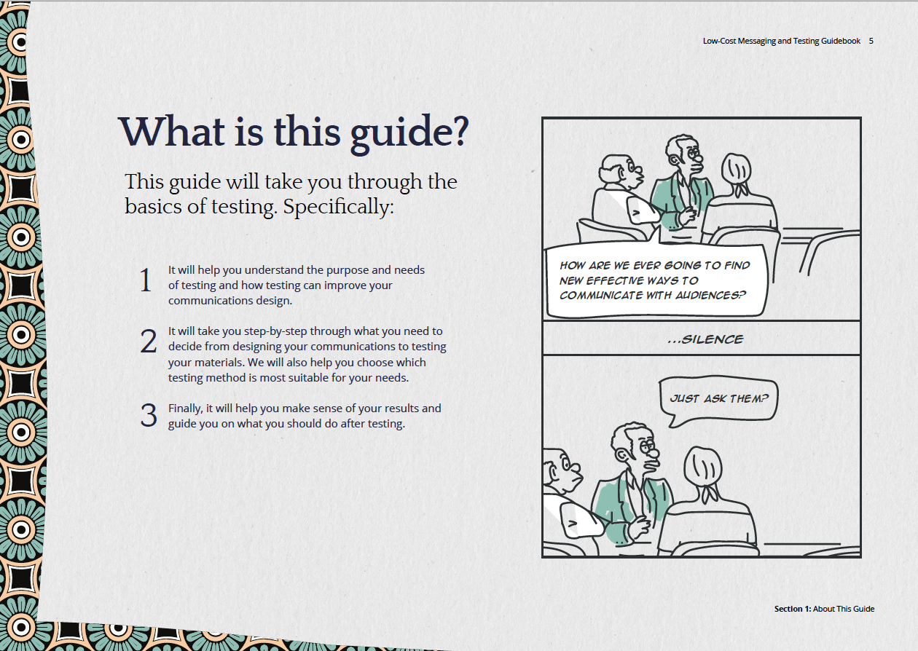
Notes:
The LCMT Guidebook is a resource for CSOs that outlines various mechanisms of testing communication campaigns before scaling them up.

Slide 8
The LCMT Guidebook is an open-resource developed to strengthen advocacy communication to achieve behavior change.
The guidebook works to:
Support organizations to streamline advocacy communication efforts by outlining the process of developing messages
Introduce testing and simplifies how qualitative and quantitative approaches can be used to test advocacy communications on a limited budget
Introduce organizations to behavioral science and how it can be integrated to advocacy communications to influence audience action.
Provide guidance on how to use testing data to enhance the messaging campaign before scaling

Slide 9
LCMT Guidebook Development Process
Inception + Selection of CSO Partners
Baseline Testing Capacity
Guidebook Content Development
Dissemination Workshop
Continued Revisions
In this phase, we shortlisted 7 CSO partners in Kenya, Uganda and Tanzania we would work with as LCM collaborators. The purpose of identifying collaborators was to ensure that Busara could appropriately speak in the right language and cadence to CSOs in East Africa which are not familiar with testing.
With the chosen 7 partners, we held a 1-hour virtual meeting with CSO representatives to introduce the project and discuss how to collaborate effectively. Moreover, we conducted a quantitative survey to assess capacities, attitudes and experiences with testing among each organization.
This is the stage where Busara started crafting the guidebook content in earnest. We used the first draft as basis to share and re-work wording, flow, and methodological selection with the CSO partners. Iterations happened both internal to Busara and external with a minimum of 5-7 iterations on both content and visual contextualization to East Africa.
In this stage, we held multiple workshops with partner CSOs and new East African CSO organizations to assess their reception of the guidebook, explore points for revision, and largely present how to incorporate the guidebook into their own work.
After the workshop, we have continued to fine-tune the guidebook before it was officially released to the community of East African CSOs in 2021.
In 2024, we translated the guidebook into Swahili and updated the guidebook website to make it more user friendly for CSOs in the region.

Slide 10
What value does the toolkit bring to the SBCC space?
It is an open-resource, users do not need to pay anything to use it.
It simplifies complex approaches such as research methods and behavioral science in messaging by providing step-by-step guidance on the application of concepts.
It has relatable case studies that mirrors some of the work organizations do
Beyond the Guidebook, Busara regularly produces other forms of knowledge products such as newsletters, blog posts and research publications related to SBCC that complement the information provided in the guidebooks.
The guidebook has a dedicated website that is interactive and has up to date information on the latest publications and upcoming learning events that organizations can participate in.
Busara conducts regular learning initiatives on effective SBCC to support in empowering civil society based on the guidebook

Slide 11
LCMT Learning Initiative with a Uganda project partner
Strengthening teams
Targeted learning
Weekly training
In 2022-2023, we engaged one of our project partners in a capacity-strengthening initiative with their teams in communications, editorial and marketing.
The training aimed to support our partner to test user experience to identify buyer experiences with the magazine and to adopt testing messages before scaling
We engaged the relevant teams in weekly training sessions. The sessions used a classroom-style approach but they were interactive and practical with actual case studies for the learners to apply concepts.

Slide 12
The training was implemented in a 3-part engagement:
Busara-Led Training
Busara-led training
Busara lead the engagement by facilitating a classroom-style training for 12 weeks. Each weekly session was for 2 hours. The curriculum was informed by LCMT.
Live support
Staff were provided with direct support in an ongoing communication campaign to contextualize the concepts
Partner-led initiative
The participating organization led this phase of the engagement by leveraging on the methods and skills learnt in phase 1 and 2.

Slide 13
The training was implemented in a 3-part engagement:
Live Support
Busara-led training
Busara lead the engagement by facilitating a classroom-style training for 12 weeks. Each weekly session was for 2 hours. The curriculum was informed by LCMT.
Live support
Staff were provided with direct support in an ongoing communication campaign to contextualize the concepts
a
Partner-led initiative
The participating organization led this phase of the engagement by leveraging on the methods and skills learnt in phase 1 and 2.

Slide 14
The training was implemented in a 3-part engagement:
TUI-Led Initiative
Busara-led training
Busara lead the engagement by facilitating a classroom-style training for 12 weeks. Each weekly session was for 2 hours. The curriculum was informed by LCMT.
Live support
Staff were provided with direct support in an ongoing communication campaign to contextualize the concepts
Partner-led initiative
The participating organization led this phase of the engagement by leveraging on the methods and skills learnt in phase 1 and 2.

Slide 15
Following the training, the organization has expressed the positive impact the training and toolkit has had in strengthening their communications with their target audience.

Slide 16
Ways to use the LCMT Guidebook in your organization
Training of new hires | The guidebook can be instituted as part of the onboarding process for new hires in specific communications-related departments.
Refresher training | The content and techniques in the guidebook can be adopted for refresher trainings where necessary to help people to build on knowledge on effective advocacy communication.
Develop targeted training | Organizations can develop topic-specific training sessions on based on the different sections in the guidebook that are relevant in building the skills of different team members.
Promote peer learning | You can share this guidebook with other organizations in your network whom you think will benefit from such knowledge and tools.
Reference tool | Continue using on the Low-Cost Message Testing Guidebook as a reference and learning tool on developing effective messages. You can also visit the guidebook website: <messagetestingguide.busara.global>
Join our mailing list | We engage with our partners regularly to learn more about their work, disseminate knowledge on SBCC and behavioral science through our blogs and newsletters. Be part of our mailing list to access such information..

Slide 17
Thank you

