Slide 1


Slide 2
Date:
September 23, 2024
Presentation on:
Introduction to Behavioural Science

Slide 3


Contents
What is Behavioural Science?
Applications of Behavioural Science
How to Think About Behaviour

Slide 4

What is
Behavioural Science?
A quick overview

Slide 5
Behavioural science is the study of human behaviour.
Through systematic locally embedded research we can explain why humans make the decisions they make.
We can apply the evidence we gather about human behaviour to design and test interventions to problems in areas like conservation and integrated catchment management.
Notes:
When we refer to behavioral science, we are referring to gathering evidence about human behavior which can be applied to address a variety of problems.
Say there are challenges engaging stakeholders to engage with conservation efforts.
We could utilize behavioral science when designing enrollment strategies into ICM sessions.
This means that when we design a strategy, we base it on the evidence about why stakeholders do and don’t engage with conservation/ICM efforts

Slide 6
Our minds are far less independent than we would like to believe.
Behavioural science explains that humans are not rational; we are influenced by a variety of external factors and biases in our decision-making process.
Notes:
Our mind has limitations.
We have limited memory, limited attention, and limited ability to process information.
So, we often rely on mental shortcuts to decide what to do.

Slide 7




Our minds are far less independent than we believe
Environment
Memory
Motivation
Peers

Slide 8
Look at the following problem:
2 x 2 = ?
Source: Thinking Fast and Slow- Daniel Kahneman
Notes:
Our mind has limitations.
We have limited memory, limited attention, and limited ability to process information.
So, we often rely on mental shortcuts to decide what to do.

Slide 9
Most of the time, mental shortcuts work really well
Identify a person you know in a crowd
Identify emotions of others
Identifying and responding to danger
Notes:
When we refer to behavioral science, we are referring to gathering evidence about human behavior which can be applied to address a variety of problems.
Say there are challenges engaging stakeholders to engage with conservation efforts.
We could utilize behavioral science when designing enrollment strategies into ICM sessions.
This means that when we design a strategy, we base it on the evidence about why stakeholders do and don’t engage with conservation/ICM efforts

Slide 10
Now look at this problem:
22 x 17 = ?
Source: Thinking Fast and Slow- Daniel Kahneman
Notes:
Our mind has limitations.
We have limited memory, limited attention, and limited ability to process information.
So, we often rely on mental shortcuts to decide what to do.

Slide 11
Other times, we have to put mental effort to make a decision
What crops should I plant?
Where do I graze my animals?
Who can I trust in my community?
Notes:
When we refer to behavioral science, we are referring to gathering evidence about human behavior which can be applied to address a variety of problems.
Say there are challenges engaging stakeholders to engage with conservation efforts.
We could utilize behavioral science when designing enrollment strategies into ICM sessions.
This means that when we design a strategy, we base it on the evidence about why stakeholders do and don’t engage with conservation/ICM efforts

Slide 12
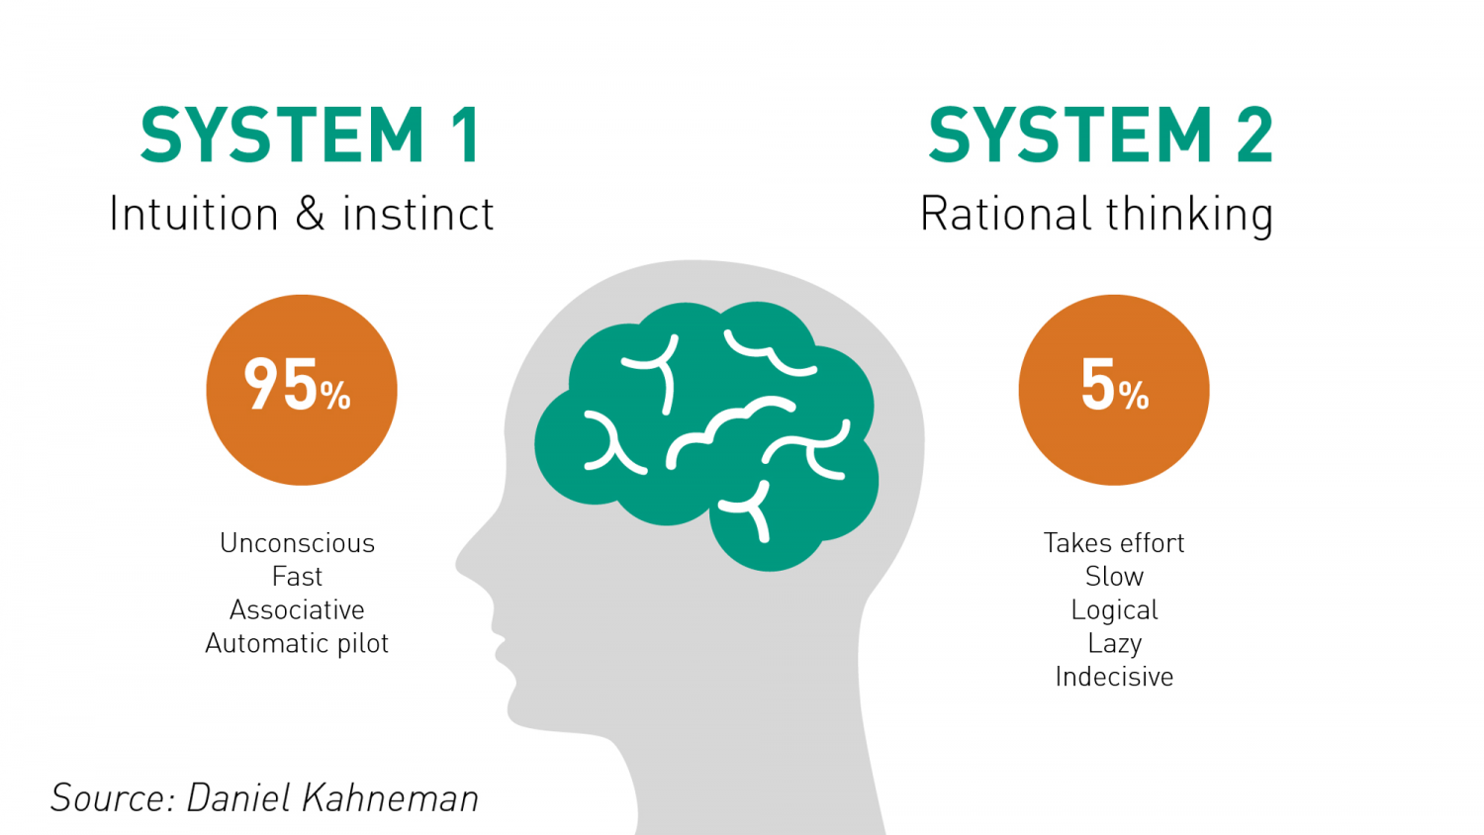
Two different ways of making decisions
Notes:
Our mind has limitations.
We have limited memory, limited attention, and limited ability to process information.
So, we often rely on mental shortcuts to decide what to do.

Slide 13

Our present behaviour depends on many prior decisions and behaviours
Whether we perform a specific behaviour at a given moment in time depends on a series of decisions and behaviours that take place beforehand.
Notes:
Insight 2 is that our present behaviour depends on many prior decisions and behaviours

Slide 14
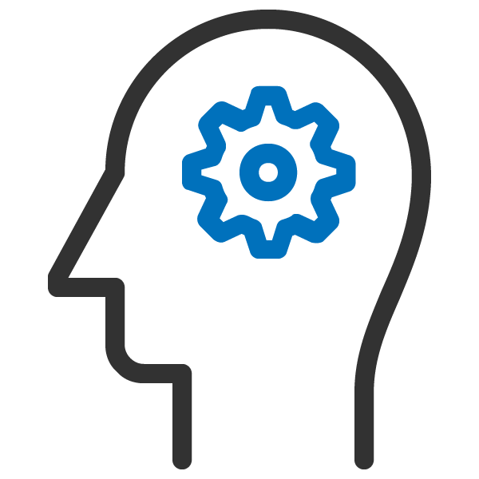



Desire
Intention
Action
Outcome
Decision-making Process
Notes:
Our mind has limitations.
We have limited memory, limited attention, and limited ability to process information.
So, we often rely on mental shortcuts to decide what to do.

Slide 15
Desire
Intention
Action
Outcome
To use organic manure
To use organic manure
Uses organic manure
Better soil conservation
Decision-making Process
Notes:
Our mind has limitations.
We have limited memory, limited attention, and limited ability to process information.
So, we often rely on mental shortcuts to decide what to do.

Slide 16
Desire
Intention
Action
Outcome
To use organic manure
To use organic manure
Uses organic manure
Better soil conservation
Decision-making Process
Notes:
Our mind has limitations.
We have limited memory, limited attention, and limited ability to process information.
So, we often rely on mental shortcuts to decide what to do.

Slide 17
Desire
Intention
Action
Outcome
To use organic manure
To use organic manure
Uses organic manure
Better soil conservation
I’m not sure what I want.
I’ll do it tomorrow.
What’s everyone else doing?
It’s too complicated.
I’m not in the mood.
It’ll take too long.
It isn’t what I thought it would be.
Decision-making Process
Notes:
Our mind has limitations.
We have limited memory, limited attention, and limited ability to process information.
So, we often rely on mental shortcuts to decide what to do.

Slide 18
Desire
Intention
Action
Outcome
To use organic manure
To use organic manure
Uses organic manure
Better soil conservation
Timeliness
Framing
Social Proof
Simplicity
Aspirations
Framing
Decision-making Process
Notes:
Our mind has limitations.
We have limited memory, limited attention, and limited ability to process information.
So, we often rely on mental shortcuts to decide what to do.

Slide 19
What are the consequences of these biases?
Biases could mean our intentions may never become actions.
Stakeholders may want the best for the environment but not behave accordingly.
E.g: Farmers may base their decision to utilize organic manure based on how easily they can think of other farmers that use organic manure, instead of whether the manure would provide benefits to their crop yield.
Notes:
So, what are the consequences of such biases?
In the context of conservation/ICM, farmers might decide whether to use organic manure based on how easily they can think of other farmers that have utilized organic manure
and not whether they think their field, crop yield, and environment would benefit from organic manure or not

Slide 20

There are many biases that shape human behavior
Representativeness
The use of similar attributes to judge the likelihood of an event occurring. As opposed to using a more comprehensive approach that would utilize statistics (e.g., base rates) to determine likelihood.
.
Endowment Effect
Individuals tend to overvalue something that they see as belonging to them.
Social Norms
When an individual looks to the behaviour of their peers to inform their decision­ making, and their tendency to conform to the same behaviour their peers are engaged in.
Confirmation Bias
Selectively paying attention to information that confirms one’s opinions or conclusions rather than information that is contradictory.
Availability & Affect
Information that readily comes to mind is used to make a decision rather than using a comprehensive set of facts that evaluates all options.
.
Anchoring
To make an estimate by applying adjustments to a particular reference value (i.e., the “anchor”).
Salience
Giving undue attention to things that are vivid or obvious, thereby missing important information
Info / Choice Overload
Presence of too much information (/ choice) in the environment, preventing the individual from evaluating and making a good decision.
Status Quo Bias
The preference to maintain their current state and avoid changes, even beneficial ones
Present Bias
Favoring immediate payoffs over future ones
Affect Heuristic
a reliance on good or bad feelings experienced in relation to a stimulus.
Loss Aversion
When individuals are more attuned to losses than to gains.
Notes:
These biases can be barriers to behaviour

Slide 21
Applications of
Behavioural Science
Effective public messaging for public good

Slide 22
Please read out loud the following words:

Slide 23
Please read out loud the following words:
RED

Slide 24
Please read out loud the following words:
RED
BLUE

Slide 25
Please read out loud the following words:
RED
BLUE
GREEN

Slide 26
Please read out loud the following words:
RED
BLUE
GREEN
ORANGE

Slide 27
Please read out loud the following words:
RED
BLUE
GREEN
ORANGE
PURPLE

Slide 28
Please read out loud the following words:
RED
YELLOW
BLUE
GREEN
ORANGE
PURPLE

Slide 29
Please read out loud the following words:
RED
YELLOW
BLUE
PINK
GREEN
ORANGE
PURPLE

Slide 30
Please read out loud the following words:
RED
YELLOW
BLUE
PINK
GREEN
WHITE
ORANGE
PURPLE

Slide 31
Please read out loud the following words:
RED
YELLOW
BLUE
PINK
GREEN
WHITE
ORANGE
BLUE
PURPLE

Slide 32
Please read out loud the following words:
RED
YELLOW
BLUE
PINK
GREEN
WHITE
ORANGE
BLUE
PURPLE
BROWN

Slide 33
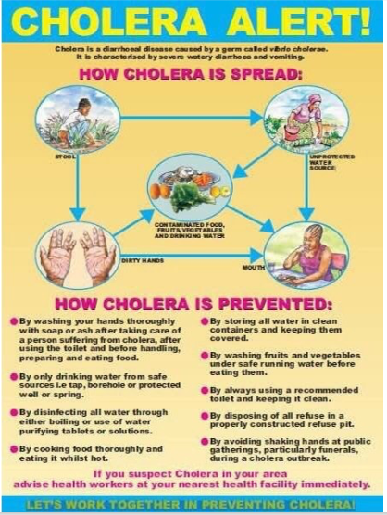
When information is not simple, easy or relevant, people take longer to understand and more likely to make errors
Standard Health Messaging:

Slide 34
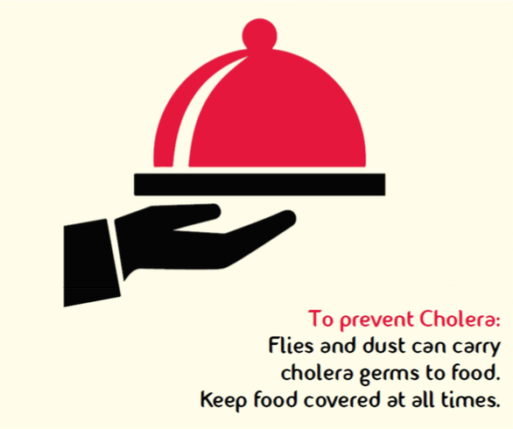
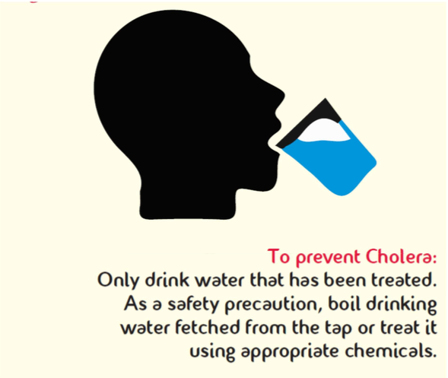
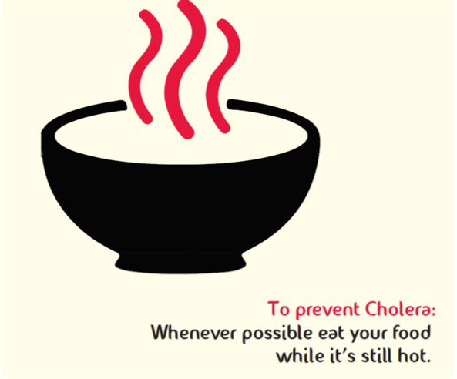
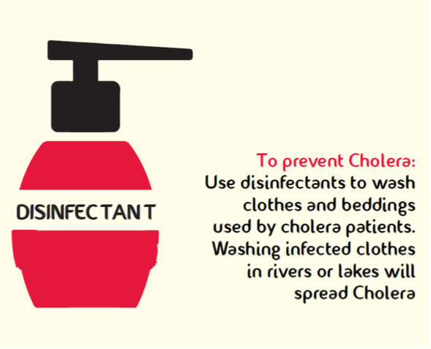
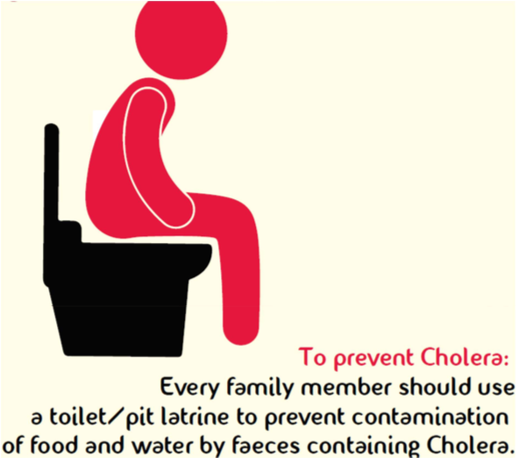
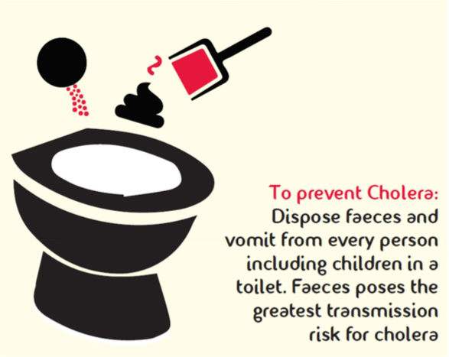
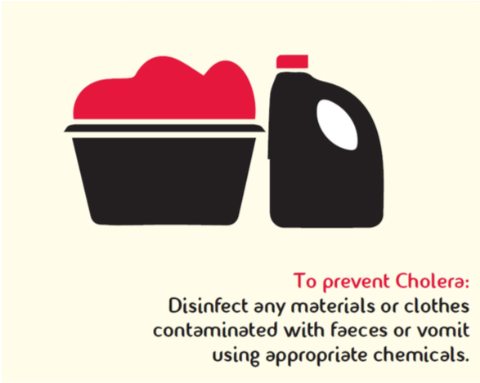
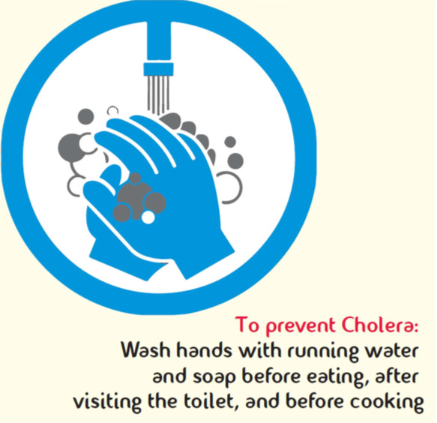

When information is not simple, easy or relevant, people take longer to understand and more likely to make errors
Standard Health Messaging:
Making the message simpler, easier and relevant:

Slide 35
Take out your phone and memorize the last 3 digits of the last number you called.
You have 15 seconds!

Slide 36
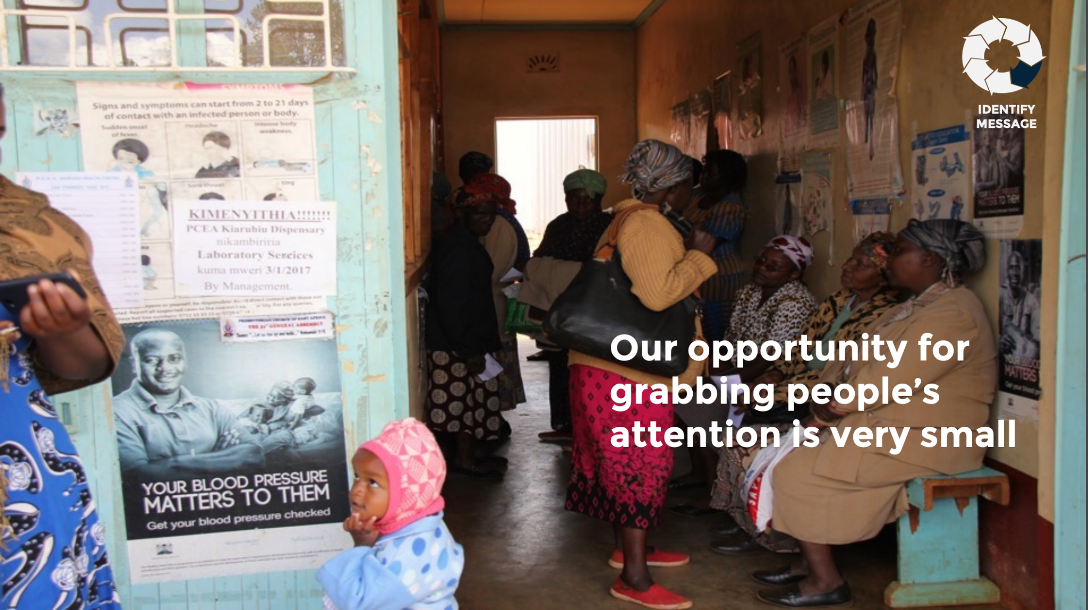
Our opportunity for grabbing people’s attention is very small.

Slide 37
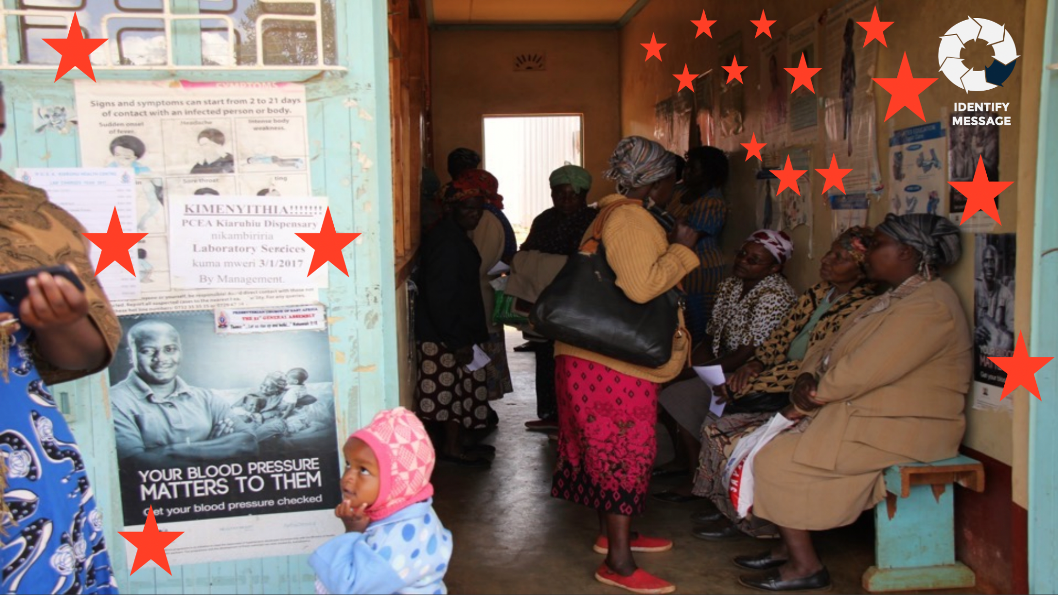

Slide 38
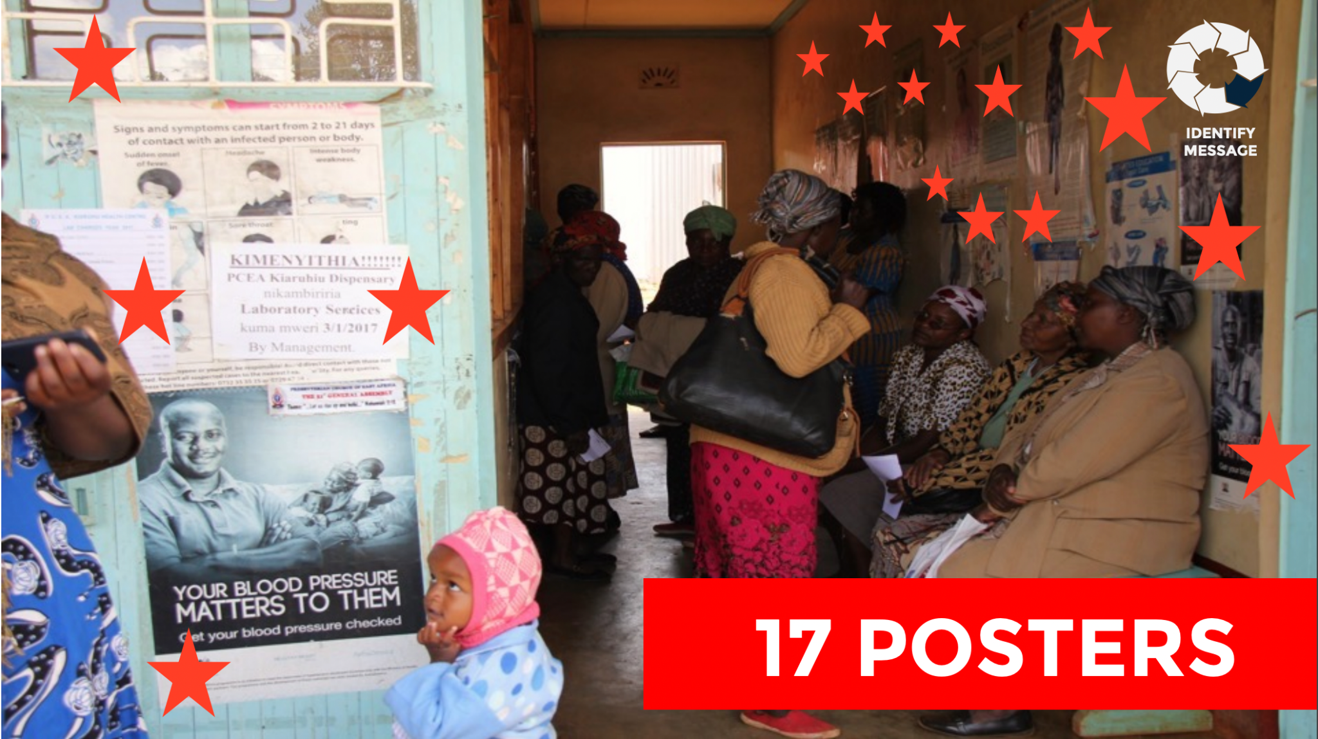

Slide 39
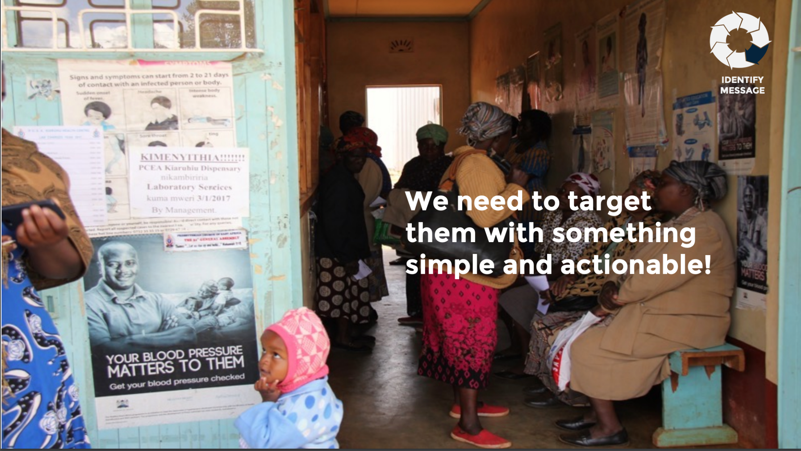
People need to be targeted with messages that are simple and actionable!

Slide 40
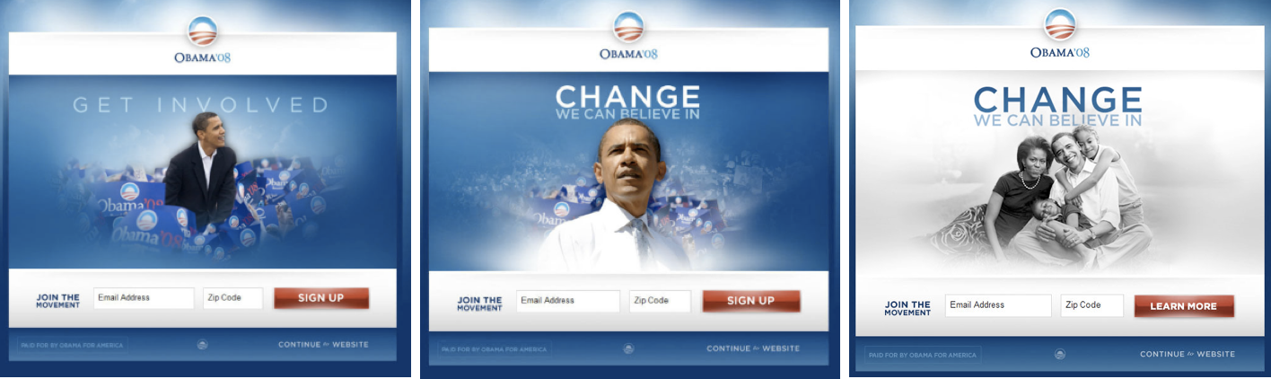
Which page was more effective?
A
B
C

Slide 41
Which page was more effective?
A
B
C

Slide 42
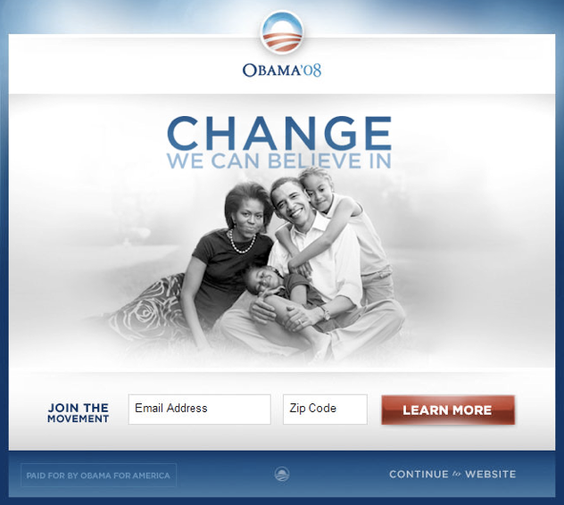
Obama 2008 Campaign Splash Page
11.6%
conversion rate compared to 8.26% for the original
40%
improvement in sign-up rate
2.88m
additional email addresses
+ $60m
in additional campaign donations

Slide 43
So, what does a behavioral science offer?
Understand
Design
Assess
A rigorously developed base of insights to help us understand and define the behaviors in question.
Identify a relevant set of interventions and techniques that can influence decision making towards the desired outcomes.
The tools to assess whether interventions are changing behavior and why or why not.
Notes:
When we refer to behavioral science, we are referring to gathering evidence about human behavior which can be applied to address a variety of problems.
Say there are challenges engaging stakeholders to engage with conservation efforts.
We could utilize behavioral science when designing enrollment strategies into ICM sessions.
This means that when we design a strategy, we base it on the evidence about why stakeholders do and don’t engage with conservation/ICM efforts

Slide 44
How to Think
About Behaviour
Behavioural Models and Frameworks

Slide 45
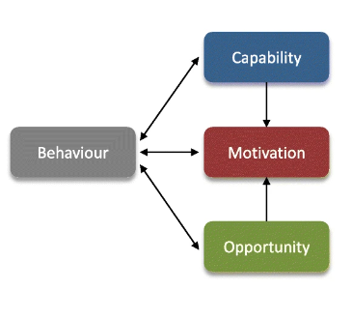
What is needed for any behaviour?
There are 3 primary components for a behaviour to occur
Notes:
As we previously indicated, we use mental shortcuts to make decisions and any behavior is the result of many prior decisions and behaviours.
But, what is needed for behaviour?
A very simple framework to help us think about what behaviour is, is the COM-B Model. It describes how behaviour is

Slide 46
What is capability?
Capability is a measure of whether an individual is even able to engage in a particular behaviour. This includes:
Physical capability: Physical ability to perform the behaviour. E.g learning to ride a bike needs physical strength and coordination to balance and pedal.
Psychological capability: Mental skills or knowledge to perform the behavior. E.g. Needing to learn the rules of healthy eating before they can follow a balanced diet.

Slide 47
What is opportunity?
Opportunity captures whether an individual is allowed to engage in the behaviour. This includes:
Physical opportunity: Whether the environment provides the resources or settings for the behavior. E.g. No bike lanes or safe roads can deter even capable cyclists.
Social opportunity: Social factors like cultural norms or peer pressure. E.g. people might be more likely to eat healthy if their social group exercise regularly and make healthy choices.

Slide 48
What is motivation?
Motivation captures whether an individual wants to engage in the behaviour. This includes:
Automatic motivation: Habits and emotional reactions. E.g. Automatically reaching for a cigarette during stressful situations because it's a habit, even if they consciously want to quit.
Reflective motivation: Conscious decision-making, like setting personal goals. E.g. Deciding to exercise regularly because they understand its long-term health benefits.

Slide 49
Exercise
Let’s practice thinking like a behavioral scientist!

Slide 50
Exercise: How can this manifest?
Behaviour:
What would a farmer need in order to use organic manure in their fields?
Capability (Ability to engage):
Opportunity (Allowed to engage):
Motivation (Wants to engage):

Slide 51
Thank you

