Slide 1


Slide 2
Date:
September 24, 2024
Presentation on:
Behavioural Mapping

Slide 3


Contents
Recap
Actor Personas
What Impacts Behaviour
Behavioural Maps

Slide 4
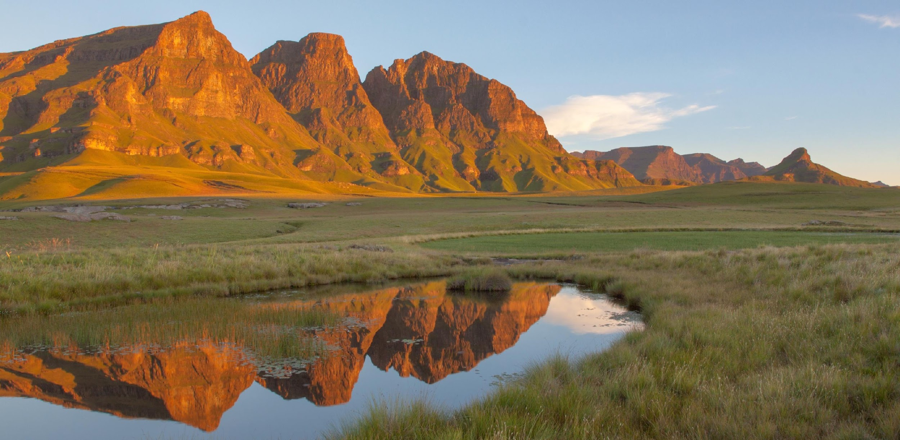
Introductions
Your name, department/organisation, role, and a word that starts with the same letter as your name that describes who you are

Slide 5
Recap
What did we do yesterday?

Slide 6
Behavioural science is the study of human behaviour.
Through systematic locally embedded research we can explain why humans make the decisions they make.
We can apply the evidence we gather about human behaviour to design and test interventions to problems in areas like conservation and integrated catchment management.
Notes:
When we refer to behavioral science, we are referring to gathering evidence about human behavior which can be applied to address a variety of problems.
Say there are challenges engaging stakeholders to engage with conservation efforts.
We could utilize behavioral science when designing enrollment strategies into ICM sessions.
This means that when we design a strategy, we base it on the evidence about why stakeholders do and don’t engage with conservation/ICM efforts

Slide 7
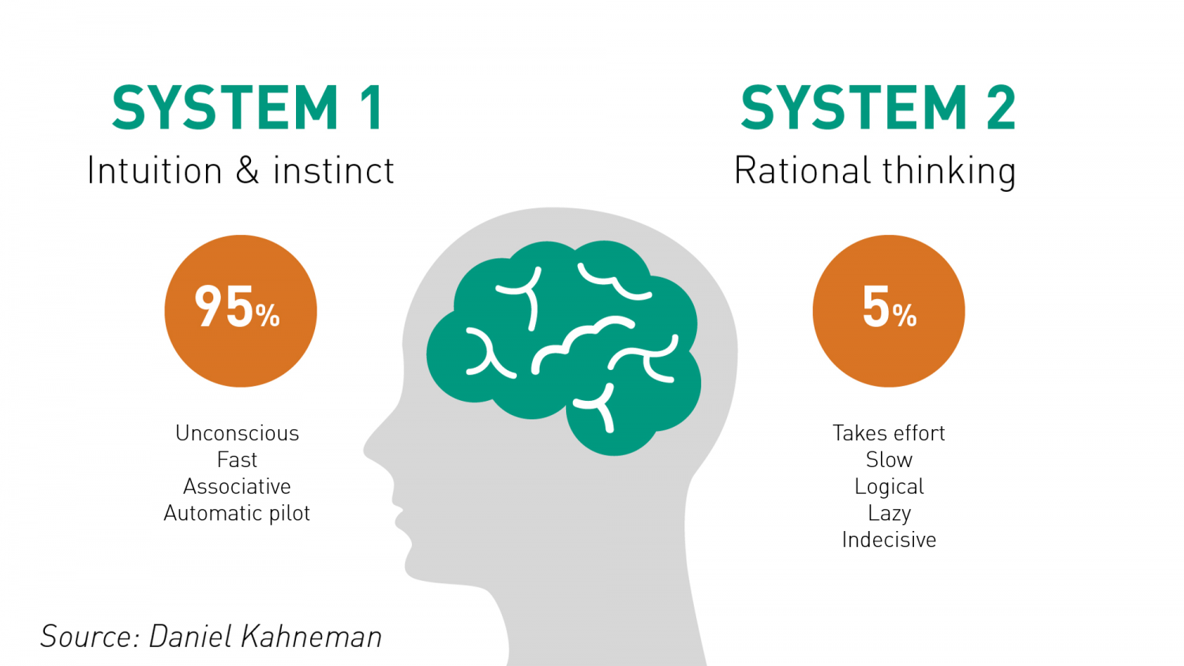
Two different ways of making decisions
Notes:
Our mind has limitations.
We have limited memory, limited attention, and limited ability to process information.
So, we often rely on mental shortcuts to decide what to do.

Slide 8

Our present behaviour depends on many prior decisions and behaviours
Whether we perform a specific behaviour at a given moment in time depends on a series of decisions and behaviours that take place beforehand.
Notes:
Insight 2 is that our present behaviour depends on many prior decisions and behaviours

Slide 9




Desire
Intention
Action
Outcome
To use organic manure
To use organic manure
Uses organic manure
Better soil conservation
Decision-making Process
Notes:
Our mind has limitations.
We have limited memory, limited attention, and limited ability to process information.
So, we often rely on mental shortcuts to decide what to do.

Slide 10
Desire
Intention
Action
Outcome
To use organic manure
To use organic manure
Uses organic manure
Better soil conservation
I’m not sure what I want.
I’ll do it tomorrow.
What’s everyone else doing?
It’s too complicated.
I’m not in the mood.
It’ll take too long.
It isn’t what I thought it would be.
Decision-making Process
Notes:
Our mind has limitations.
We have limited memory, limited attention, and limited ability to process information.
So, we often rely on mental shortcuts to decide what to do.

Slide 11
Desire
Intention
Action
Outcome
To use organic manure
To use organic manure
Uses organic manure
Better soil conservation
Timeliness
Framing
Social Proof
Simplicity
Aspirations
Framing
Decision-making Process
Notes:
Our mind has limitations.
We have limited memory, limited attention, and limited ability to process information.
So, we often rely on mental shortcuts to decide what to do.

Slide 12
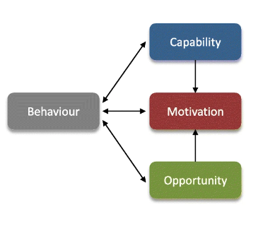
What is needed for any behaviour?
Notes:
As we previously indicated, we use mental shortcuts to make decisions and any behavior is the result of many prior decisions and behaviours.
But, what is needed for behaviour?
A very simple framework to help us think about what behaviour is, is the COM-B Model. It describes how behaviour is

Slide 13
What is capability?
Capability is a measure of whether an individual is even able to engage in a particular behaviour. This includes:
Physical capability: Physical ability to perform the behaviour. E.g learning to ride a bike needs physical strength and coordination to balance and pedal.
Psychological capability: Mental skills or knowledge to perform the behavior. E.g. Needing to learn the rules of healthy eating before they can follow a balanced diet.

Slide 14
What is opportunity?
Opportunity captures whether an individual is allowed to engage in the behaviour. This includes:
Physical opportunity: Whether the environment provides the resources or settings for the behavior. E.g. No bike lanes or safe roads can deter even capable cyclists.
Social opportunity: Social factors like cultural norms or peer pressure. E.g. people might be more likely to eat healthy if their social group exercise regularly and make healthy choices.

Slide 15
What is motivation?
Motivation captures whether an individual wants to engage in the behaviour. This includes:
Automatic motivation: Habits and emotional reactions. E.g. Automatically reaching for a cigarette during stressful situations because it's a habit, even if they consciously want to quit.
Reflective motivation: Conscious decision-making, like setting personal goals. E.g. Deciding to exercise regularly because they understand its long-term health benefits.

Slide 16
How did we think this manifests?
Capability:
Physically active, Skillset, Knowledge, Training, Transport, Manpower
Behaviour:
What would a farmer need in order to use organic manure in their fields?
Opportunity:
Access to materials, availability of materials, Other people using manure, Social Norms, Traditions, Collaborators
Motivation:
Social responsibility, peer pressure influencers, risk, perceived benefits: health, money, status, cost-effectiveness
Notes:
REPLACE WITH FILLED OUT EXERCISE

Slide 17
Busara advances and applies behavioral science in the Global South.

Slide 18
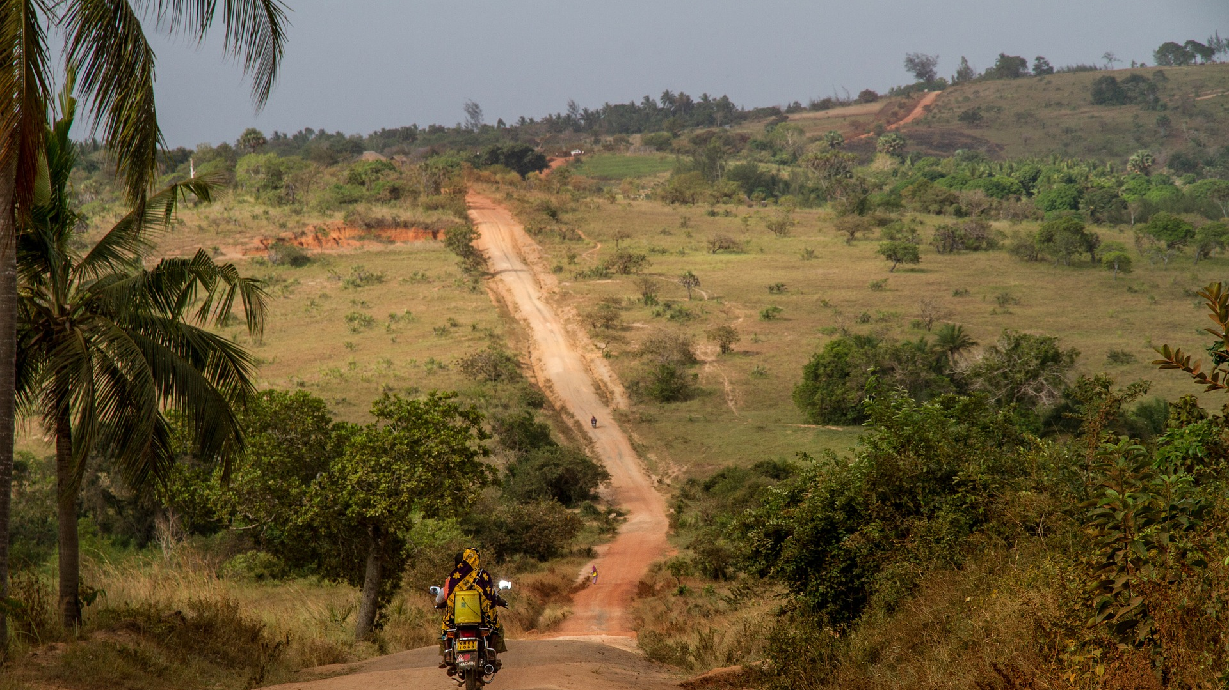
At Busara, we want to bridge two worlds: the real world and the world of research.

Slide 19
Busara in numbers
145
3
112
69
Full-time staff
Decision Labs
Completed Projects
Active Projects

Slide 20
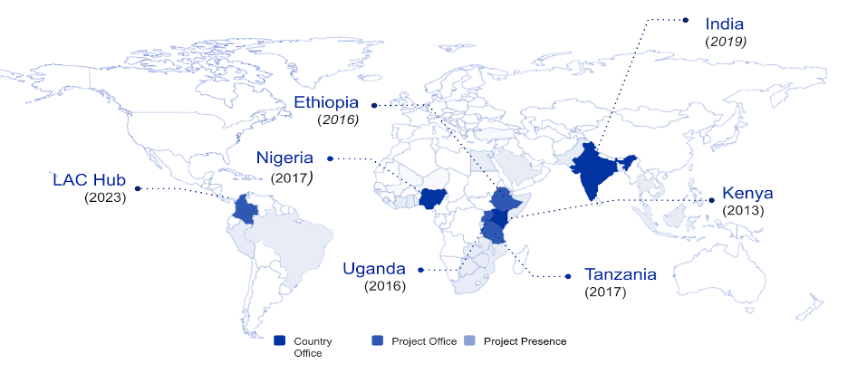
Our presence

Slide 21
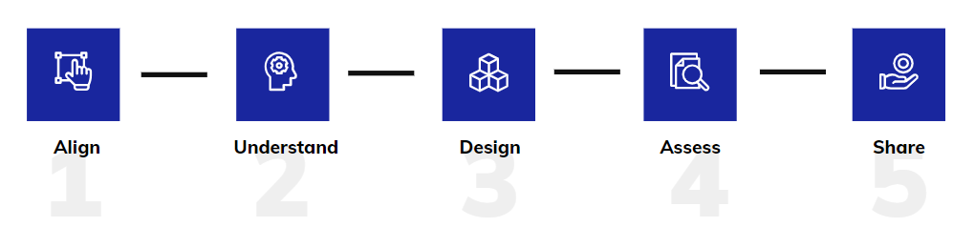
What is AUDAS?
AUDAS is Busara’s approach to behavioural change
It provides a framework for incorporating evidence and behavioural science principles into our work

Slide 22
Our Workshops
Over the 3 workshops that we will conduct with all of you, we will go through these 3 crucial steps of our approach to using behavioural science and evidence in projects and communications.

Slide 23
Today
Today, we will focus on the Understand stage. By the end of the day, you will have the tools you need, and a plan in place, to understand your chosen behavioural science problem.

Slide 24
What do we need to Understand?
We need to understand the context: the location, cultural setting, and lived experiences of local people
We need to understand the population we are trying to target with our project
We need to understand how receptive the context is to different types of interventions
We need to understand which obstacles from the literature apply to our context
We need to understand which obstacles are unknown or culturally sensitive in our context
Question:
Why do we need to understand all of these factors?

Slide 25
Strategies to help us Understand: Literature Review
Literature Reviews
Qualitative Research:
In-Depth Interviews
Key Informant Interviews
Focus Group Discussions
Observation

Slide 26
Exploratory Qualitative Research
Qualitative research is used to understand WHY
The different qual research methods (IDIS, KIIs and FGDs) are applied in different contexts based on the information that you need.
Do not ask leading questions, have open-ended questions, do not use technical words and not have too many questions.
Test your instruments with a sample sample of the target audience before rolling out your research.

Slide 27
Yesterday we asked each organisation/department
4 key questions
What is the specific behaviour you are trying to change?
Whose behaviour needs to change?
Can you take this action?
How will you know it worked?

Slide 28
Here is how Busara answered it for 1 of our studies
What is the specific behaviour you are trying to change?
Whose behaviour needs to change?
Can you take this action?
How will you know it worked?
Yes we can work with ReNOKA and conduct an intervention
Implementation of grazing practices and reduced soil erosion
Better grazing practices (e.g., rotational grazing)
Animal owners and Herders

Slide 29
Leading us to
Our goal is to increase adoption of sustainable rangeland management practices by animal owners and herders to reduce soil erosion
What is the specific behaviour you are trying to change?
Whose behaviour needs to change?
Can you take this action?
How will you know it worked?

Slide 30
Action Plans
Now, let us present our own answers and come up with statements that we will work on for the rest of the day
After your group has a statement, please write it down on Question 1A of the action plan worksheet
What is the specific behaviour you are trying to change?
Whose behaviour needs to change?
Can you take this action?
How will you know it worked?

Slide 31
Actor Personas
Understanding the Components of Behaviour

Slide 32
Key Actors
Key actors are the individuals who play a significant role in influencing or driving the behaviours you are aiming to change.
For integrated catchment management in Lesotho, these actors could include community members like farmers, herders,community elders etc.

Slide 33
Actor Personas
You could create profiles for key actors to understand what drives their actions.
We recommend generating multiple profiles for all key actors and compare them to understand the similarities and differences in what drives their behaviours.
A Persona includes the responsibilities, motivations, habits, permissions, influences and surrounding community of a key actor. They help us see the whole person, and understand how a specific issue affects them directly.

Slide 34

Group Activity:One
We are going to work in groups with the other members of our ministries/departments/ organisations for 30 minutes.
We are going to develop a Key Actor Persona for the main stakeholder of our programs or messaging
You will work in your groups to identify:
Environmental Factors
Sociological Factors
Psychological Factors
Make guesses and assumptions in areas you are unsure about, indicating these by putting a * symbol next to the guess

Slide 35
Actor Persona - Case Study
Actor: Farmer
Environmental
Background and environment
Where I live / Who I live with (geography and conditions)
I live with my wife, children, and parents
We have a small plot of land & farm it
I’ve lived in this village my whole life
Responsibilities
In my family and my community, I believe my responsibility is to:
Support my family financially
Raise my children well
Follow the teachings of my church
Be a strong member of my community
Concerns
Other things that are happening simultaneously or competing for my attention:
The weather makes it hard to figure out when to plant and how much water and care my land needs, some years my crop is low
I also tend to a few small animals that I’m raising to eat or maybe sell
I only have a little money in savings
Notes:
Responsibilities
In my family and my community, I believe my responsibility is to:

Slide 36
Actor Persona - Case Study
Actor: Farmer
Sociological
Influences
For guidance, I go to:
Community Elders
My Priest
My Chief
My Neighbors
Other Farmers
Community & culture
What I like most about my community:
We are a respectable community and families support each other
What I would like to change about my community:
It would be nice to have more reliable electricity
More opportunities to earn money
Power & permissions
Decisions I can make on my own:
What to farm, how I farm, how I spend my time
Decisions I cannot make on my own:
What other farmers do on their land
Notes:
Responsibilities
In my family and my community, I believe my responsibility is to:

Slide 37
Actor Persona - Case Study
Actor: Farmer
Psychological
Motivations
I hope people will say that I am:
A hard worker
A good farmer
A nice husband and father
I fear people will say that I am:
Not doing enough for my family
Habits
My daily routine is…
Waking up early in the morning
Going to the field and tending to my crops
Talking with friends and neighbors
Spending time with my family
Going to bed early
My weekly routine is…
Going to church every Sunday
My monthly routine is…
Making sure my family has enough for our necessities
My yearly routine is…
Farming, selling the harvest, finding alternative work during off-season, planning for the next year
Notes:
Responsibilities
In my family and my community, I believe my responsibility is to:

Slide 38
Actor Persona - Case Study
Actor: Farmer
Environmental
Background and environment
Where I live / Who I live with (geography and conditions)
I live with my wife, children, and parents
We have a small plot of land & farm it
I’ve lived in this village my whole life
Sociological
Influences
For guidance, I go to:
Community Elders
My Priest
My Chief
My Neighbors
Other Farmers
Psychological
Motivations
I hope people will say that I am:
A hard worker
A good farmer
A nice husband and father
I fear people will say that I am:
Not doing enough for my family
Concerns
Other things that are happening simultaneously or competing for my attention:
The weather makes it hard to figure out when to plant and how much water and care my land needs, some years my crop is low
I also tend to a few small animals that I’m raising to eat or maybe sell
I only have a little money in savings
Community & culture
What I like most about my community:
We are a respectable community and families support each other
What I would like to change about my community:
It would be nice to have more reliable electricity
More opportunities to earn money
Habits
My daily routine is…
Waking up early in the morning
Going to the field and tending to my crops
Talking with friends and neighbors
Spending time with my family
Going to bed early
My weekly routine is…
Going to church every Sunday
My monthly routine is…
Making sure my family has enough for our necessities
My yearly routine is…
Farming, selling the harvest, finding alternative work during off-season, planning for the next year
Responsibilities
In my family and my community, I believe my responsibility is to:
Support my family financially
Raise my children well
Follow the teachings of my church
Be a strong member of my community
Power & permissions
Decisions I can make on my own:
What to farm, how I farm, how I spend my time
Decisions I cannot make on my own:
What other farmers do on their land
Notes:
Responsibilities
In my family and my community, I believe my responsibility is to:

Slide 39
What
Impacts Behaviour
A quick overview

Slide 40
Behavioural
Mapping

Slide 41
Micro-Behaviours
Remember that any behaviour is the result of many prior decisions and behaviours
Micro-behaviours are the smaller steps that inform a complex behaviour
Mapping these behaviours lets you understand barriers specific to each step
A precise understanding of the behaviour can inform targeted interventions, programs, and communications
Notes:
REPLACE WITH FILLED OUT EXERCISE

Slide 42
Behavioural Steps
Description of each micro-behaviour: What is the journey an individual must take in order to engage in the desired behaviour of your program?
Starting Point | Micro-Behaviour | Micro-Behaviour | Micro-Behaviour | Micro-Behaviour | Desired Behaviour
Desire to Employ Organic Manure | Learning how to make Organic Manure | Collecting Organic Waste | Mixing the Manure | Waiting for Composting | Using Organic Manure
The farmer is exposed to the concept of organic manure, either through media, an intervention, or a fellow farmer. They develop a desire to employ organic manure | The farmer learns the steps they need to take in order to make organic manure | The farmer collects organic waste from their field and surroundings | The farmer follows the learnt procedure, chopping and mixing the organic waste, adding water, then covering and turning the mixture. | The farmer waits for the organic manure to compost (until it is ready to be used) | The farmer uses the organic manure in his field
Notes:
REPLACE WITH FILLED OUT EXERCISE

Slide 43
Action Plans
After your group has written down the steps to behaviour, please write it down on the Question 1B of the action plan worksheet
What is the specific behaviour you are trying to change?
Whose behaviour needs to change?
Can you take this action?
How will you know it worked?

Slide 44
Barriers to Desired Behaviours
A barrier is a factor that may prevent a desired outcome. This means anything that could cause citizens of Lesotho to prefer engaging in behaviours harmful to the environment, such as using chemical fertilizers, overfishing, polluting etc.
Barriers are what your intervention, program, or communications should directly address.
Notes:
REPLACE WITH FILLED OUT EXERCISE

Slide 45


Two Types of Barriers
Structural Barriers
External obstacles embedded in social, economic, or institutional frameworks. These could be:
Behavioural Barriers
Psychological obstacles rooted in individual attitudes, social norms, and cultural factors. These could be:
Any applicable laws or policies
The resources are available to you and your community
  How easy it is to access these resources?
Any cognitive biases or heuristics you might employ
What you think about a behaviour
What others in your community actually do
The traditions your community adheres to

Slide 46

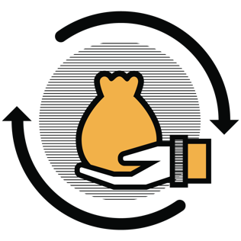

Structural Barriers
Ineffective Policies
Poverty
Coordination within Ecosystem
Inadequate Resources
Despite the existence of laws and regulations; community members might be ignorant of them or ignore them
Community members’ main priority is to make a living, which - in their view - can conflict with practicing many recommended conservation behaviours
ReNOKA partners and ministries often do not coordinate with one another effectively, leading to differing conservation advice for communities
Community members lack the tools needed to adopt conservation practices. Partners might lack the financing needed to effectively run ICM programs.
Notes:
what more can we think of?

Slide 47



Behavioural Barriers
Lack of Interest
Culture/Social Norms
Anti-Social Behaviours
Present Bias
Community members might exhibit disinterest during training initiatives. They also might not exhibit any follow through in implementing teachings
Community members are set in what their predecessors did. They might not be open to novel ideas, limittng their ability to adopt conservative measures.
Threats, and verbal and physical abuse discourages enforcers from going after unruly offenders
Community members prioritize immediate needs and gains, preventing them from adopting some conservation measures
Notes:
what more can we think of?

Slide 48
Barriers
Barriers to the micro-behaviours: What factors decrease the likelihood that the individual performs the desired behaviour?
 | Desire to Employ Organic Manure | Learning how to make Organic Manure | Collecting Organic Waste | Mixing the Manure | Waiting for Composting | Using Organic Manure
Structural Barriers | Access to learning about organic manure |  | The time he will need to spend The availability of waste materials |  |  | The difference in yield between organic and chemical fertilizers
Behavioural Barriers | Not convinced about the benefits Feels his existing fertilizer works great Averse to the risk of switching |  | Can’t remember which waste is useable He prioritises other actions over this His friends disapprove of him collecting this kind of waste |  |  | Afraid of the consequences of actually switching to organic manure (time crops take to grow) His friends are still using chemical fertilizers
Notes:
REPLACE WITH FILLED OUT EXERCISE

Slide 49
Action Plans
After your group has written down the barriers, please write it down on the Question 2 of the action plan worksheet
What is the specific behaviour you are trying to change?
Whose behaviour needs to change?
Can you take this action?
How will you know it worked?

Slide 50
Levers of Desired Behaviours
A lever is a factor that may facilitate a desired outcome. This means anything that could cause citizens of Lesotho to prefer engaging in behaviours beneficial to the environment, such as using organic manure, sticking to grazing zones, engaging in sustainable practices etc.
You can think of a lever as something that could be employed in an intervention, program, or communication to strengthen its effectiveness.
Notes:
REPLACE WITH FILLED OUT EXERCISE

Slide 51
Levers
Social Identity
Memory
Trust
Community
Community members are strongly attached to their identities (herders, farmers etc.) which could be leveraged in a norms change intervention.
Community members remember periods of abundance and want to return to those resource levels.
Community members trust subject matter experts and government officials to deliver conservation-related information
Community members that experience feelings of closeness with others are more likely to engage in conservation behaviours.

Slide 52
Levers
Levers for the micro-behaviours: What do we know about this specific situation and context that can help us?
 | Desire to Employ Organic Manure | Learning how to make Organic Manure | Collecting Organic Waste | Mixing the Manure | Waiting for Composting | Using Organic Manure
Levers | I trust the agricultural extension worker to teach me how to make manure |  |  |  |  | I want to go back to the days before when we had enough of everything

Slide 53
Intervention Opportunities
Interventions for the micro-behaviours: What can I change to increase the individual's capability, opportunity, or motivation to perform the desired behavior
 | Desire to Employ Organic Manure | Learning how to make Organic Manure | Collecting Organic Waste | Mixing the Manure | Waiting for Composting | Using Organic Manure
Interventions

Slide 54
What do I need to know?
Interventions for the micro-behaviours: What more do I need to know? Who should I ask? How?
 | Desire to Employ Organic Manure | Learning how to make Organic Manure | Collecting Organic Waste | Mixing the Manure | Waiting for Composting | Using Organic Manure
Gaps in my understanding | How do farmers find out about organic manure? Which channels do they trust the most? IDIs with farmers |  | Will community members approve of this collection? FGDs with community members |  |  | Where in the process do people stop? IDIs with farmers

Slide 55
Action Plans
After your group has written down the gaps in your understanding, please also write it down on the Question 3 of the action plan worksheet
Then, let us think about the ways we could answer those gaps. Which methods should we employ, who should we speak with, who would be best to do this, when?
Remember what we did yesterday, we are just doing the same for our projects now.
What is the specific behaviour you are trying to change?
Whose behaviour needs to change?
Can you take this action?
How will you know it worked?

Slide 56
Thank you

