Slide 1


Slide 2
Date:
September 23, 2024
Presentation on:
AUDAS - The Busara Approach

Slide 3


Contents
The AUDAS Model
Our Problem Statements
Study Findings & Recommendations

Slide 4
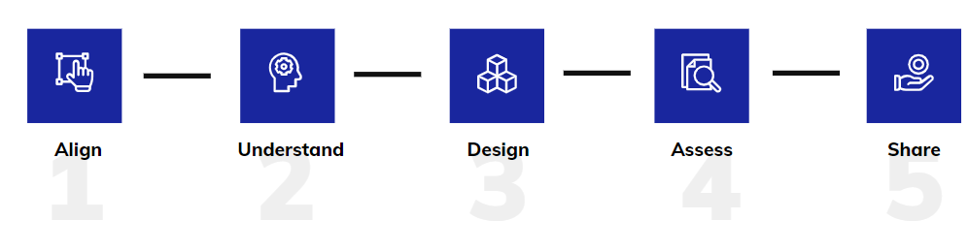
What is AUDAS?
AUDAS is Busara’s approach to behavioural change
It provides a framework for incorporating evidence and behavioural science principles into our work

Slide 5

Stage 1: Align

Slide 6
What does Aligning mean?
Aligning can mean clarifying and agreeing with stakeholders on the behavioral challenges to be addressed
Aligning can mean considering the diverse perspectives, needs, and expectations of stakeholders for your project
Question:
Why might aligning with stakeholders or your team be important?
Aligning can mean ensuring that everyone on the team is on the same page.
Aligning can mean conducting post-mortems to learn from previous work

Slide 7
What does Aligning mean?
Aligning can mean clarifying and agreeing with stakeholders on the behavioral challenges to be addressed
Aligning can mean considering the diverse perspectives, needs, and expectations of stakeholders for your project
Question:
Why might aligning with stakeholders or your team be important?
When stakeholders don’t have the same vision from the start, it can lead to challenges in the successful implementation and scalability of your projects.
Aligning can mean ensuring that everyone on the team is on the same page.
Aligning can mean post-mortems

Slide 8
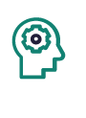
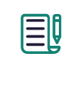
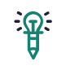
Strategies to Align with Stakeholders
Behavioral Brief: A project template outlining the scope, target actors, actions, and outcomes. It ensures all contributors share a clear understanding of the behavioral interventions.
Behavioral Hypothesis: A focused statement on the actor, action, and outcome, guiding the project with a testable change proposition for all stakeholders.
Co-Defining Concepts: Sessions with stakeholders to agree on context-specific definitions, ensuring project activities are interpreted as intended for greater effectiveness.

Slide 9
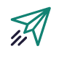
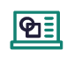
Strategies to Align with Your Team
Project Kickoff: An initial meeting to align the team and stakeholders on project goals, objectives, and the scope of the problem being addressed.
Project Management Tools: Tools to align the team, clarify responsibilities, and leverage diverse competencies during project execution.
Post-Mortem: A reflective session to assess what worked, what didn’t, and the lessons learned from previous projects. This helps improve the new project and identifies areas for growth.

Slide 10
How we did it
We conducted a kickoff presentation ti build on our common understanding of ICM in Lesotho and understand the expectations of our project, and potential challenges to its success
We utilized a variety of project management tools to ensure that our team was on the same page
We conducted internal sessions to align our working styles and competencies
We broke down tasks into smaller steps whenever possible
We assigned clear roles and responsibilities to all team members

Slide 11

Stage 2: Understand

Slide 12
What do we need to Understand?
We need to understand the context: the location, cultural setting, and lived experiences of local people
We need to understand the population we are trying to target with our project
We need to understand how receptive the context is to different types of interventions
We need to understand which obstacles from the literature apply to our context
We need to understand which obstacles are unknown or culturally sensitive in our context
Question:
Why do we need to understand all of these factors?

Slide 13
What do we need to Understand?
We need to understand how receptive the context is to different types of interventions
We need to understand the context: the location, cultural setting, and lived experiences of local people
We need to understand the population we are trying to target with our project
Question:
Why do we need to understand all of these factors?
To avoid duplication and unfruitful interventions, ground your project in the local context and invite local participation.
We need to understand which obstacles from the literature apply to our context
We need to understand which obstacles are unknown or culturally sensitive in our context

Slide 14
Strategies to help us Understand: Literature Review
A review of the literature will provide an overview of recent developments in your project area in similar contexts.
This lets you understand the factors driving the behaviors you might be looking to change, as well as what existing interventions have worked.
When conducting a literature review, it is imperative to define the scope and devote the appropriate resources and time.

Slide 15
Different Ways to Use Literature Reviews
Gain Understanding and Inspiration
Develop an understanding of the problem
Find out which factors influence behaviour
Collate interventions others have conducted to address the problem
Identify Unanswered Questions
Pinpoint gaps in the evidence base
Understand where further research could be useful
Evaluate Tools
Evaluate and compare various tools, methods, and instruments
Make decisions on which tools you will use when designing and evaluating your project

Slide 16
Strategies to help us Understand: Qualitative Research
Qualitative research is useful in addressing the gaps in the existing knowledge-base.
Focuses on the depth and richness of responses, focusing on smaller and more targeted samples than quantitative research methods
Qualitative research, when used effectively, can help shine a light on unknown, sensitive, or context-dependent factors that impact the likelihood of stakeholders performing your desired behavior

Slide 17
Different Methods of Qualitative Research
In-Depth-Interviews
Qualitative survey with open-ended questions
  Questions should be easy to understand and not leading
  Potential to uncover hidden behaviors or explanations for topics of interest
Focus Group Discussions
Gather people from similar contexts or with similar experiences
  Explore attitudes, perceptions, and beliefs through discussions on the topic of interest
  Should feel as if the focus group is a safe space
  Time-Efficient
Key Informant Interviews
Targeted interviews with stakeholders with specialised knowledge or expertise
  gain deeper insights into specific contexts, challenges, or perspectives

Slide 18
Synthesizing Your Findings
After employing some or all of the techniques outlined in this section you should have an understanding of the ways in which existing interventions work, the factors that enable and hinder your desired behavior, and which behavior change strategies are likely to be effective.
It is important to synthesize your findings into Behavioral Maps to organize your findings and guide the design of your project.

Slide 19
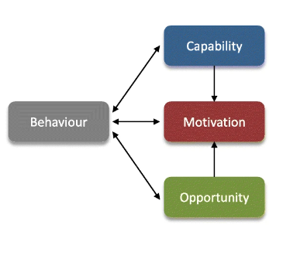
Synthesizing Your Findings: Behavioral Models
Notes:
CREATE Action Funnel, or Com-B model

Slide 20
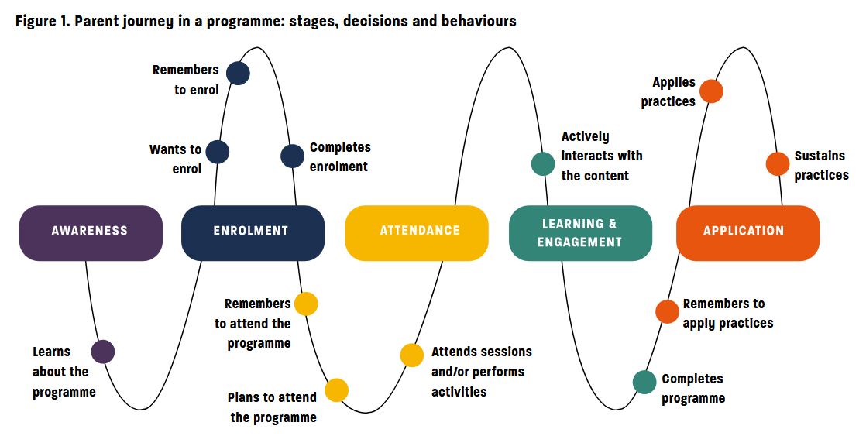
Synthesizing Your Findings: Behavioral Maps

Slide 21
How we did it
We examined guidelines from current and past programs to narrow the scope of our research. We defined clear objectives.
We reviewed existing literature related to integrated catchment management (ICM) and natural resource conservation, identifying influential factors and gaps in the research.
We conducted qualitative in-depth interviews with key stakeholders, key informant interviews with line ministry representatives, and focus group discussions with commmunity members
We synthesized these insights into a behavioral model illustrating how cognitive or psychological barriers influenced crucial conservation-related behaviors.

Slide 22

Stage 3: Design

Slide 23
Why is Design important?
We need to develop locally-relevant interventions
Our interventions must be validated by other stakeholders
Our interventions must be planned out well
We must break free from existing, ineffective solutions
Notes:
Ask the group’

Slide 24
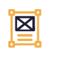
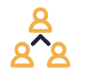
Strategies for Designing Interventions
Problem Statements: Clear, concise descriptions of the challenges an intervention aims to address. These form the basis for “How Might We” (HMW) statements, encouraging creative solutions. Problem statements should be refined throughout the design process, especially after ideation and prototyping.
Participatory Ideation: A collaborative approach where stakeholders generate ideas and solutions, ensuring those affected by the intervention contribute to its development
Co-Design Workshops: Involve target groups to generate ideas and solutions, ensuring their needs shape the intervention.
Validation Workshops: Engage partners to refine insights and ensure the intervention is practical and well-rounded.

Slide 25
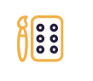
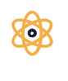
Strategies for Designing Interventions
Prototyping: A trial-and-error process where low-fidelity ideas are tested to validate their effectiveness. Prototypes evolve through cycles of failure and learning, and are assessed using qualitative or quantitative methods like surveys or focus groups.
Theory of Change: A framework outlining how your intervention is expected to drive behavior change. It identifies expected outcomes, challenges, and risks, ensuring a clear understanding of the problem and the proposed solutions, while addressing knowledge gaps before implementation.

Slide 26
How we did it
Based on our model, we generated 5 problem statements
We conducted co-design workshops with community members and validation workshops with ReNOKA stakeholders.
We narrowed down to 4 key problem statements, based on which we developed 13 prototypes.
We tested the prototypes, crafting 3 bundled interventions leveraging the strongest mechanisms for behavior change.
We developed a theory of change to outline the expected pathway to achieving the desired behaviors.

Slide 27

Stage 4: Assess

Slide 28
What does Assessing our interventions let us do?
Get a sense of how effective our approach is
Figure out which components worked and which components did not work
Iterate on our current intervention
Inform future interventions in similar topic areas/contexts
Contribute to the literature on the topic/behavior of interest
Notes:
Ask the group’

Slide 29
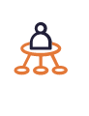
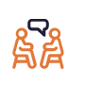
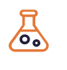
Strategies for Assessing Interventions
Piloting: Piloting tests high-fidelity interventions aimed at behavior change before full-scale implementation, focusing on optimizing effectiveness and addressing any issues. If outcomes fall short, revisit the design for adjustments.
Qualitative Feedback: Feedback from participants and implementers provides insights into how the intervention feels and works, helping refine solutions and improve processes.
Experiments: A/B Tests and Randomized Controlled Trials (RCTs) compare treatment and control groups to measure intervention impact and determine causality. RCTs help confirm if the intervention drives the desired behavior, though results depend on the representativeness of the sample.

Slide 30
How we did it
We tested the three interventions in the field across six catchment areas.
We piloted the interventions, and used qualitative survey responses and input from our field team to further develop and refine the interventions.
Then, we rolled out the interventions to all 6 catchment areas sequentially, using quantitative surveys to examine the effects of the specific behavioral mechanisms leveraged through our interventions on attitudes, knowledge, and behavior.
We compared the responses of the control group and treatment group to isolate the effects of our interventions.

Slide 31

Stage 5: Share

Slide 32
What do we need to know before we can Share our findings?
Who the audience is
What the key takeaways from the project are
Where we want to share our findings
Why it is important to share our findings

Slide 33
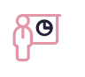
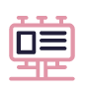
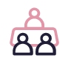
Strategies for Sharing Findings
Final Report or Presentation: A tailored report for funders and partners, focusing on clear, concise communication. It should highlight key takeaways, acknowledge strengths and shortcomings, and be adapted to the needs of different audiences.
Synthesis of Insights: Summarize insights in accessible formats like toolkits, recommendation papers, or blog posts, aimed at guiding non-technical audiences, policymakers, or funders.
Workshops: Interactive workshops engage stakeholders, enabling them to explore findings in depth and provide feedback for future projects or strategies.

Slide 34
How we did it
We shared the findings of our three research studies in technical and in-depth presentations and reports with GIZ and other partners.
We also developed a Toolkit to Applying Behavioral Science to guide readers through our approach to behavior change interventions, and a Recommendations Report to take readers through the studies we conducted: going over their strengths, shortcomings, and our insights.
We conducted a dissemination workshop with ReNOKA partners

Slide 35
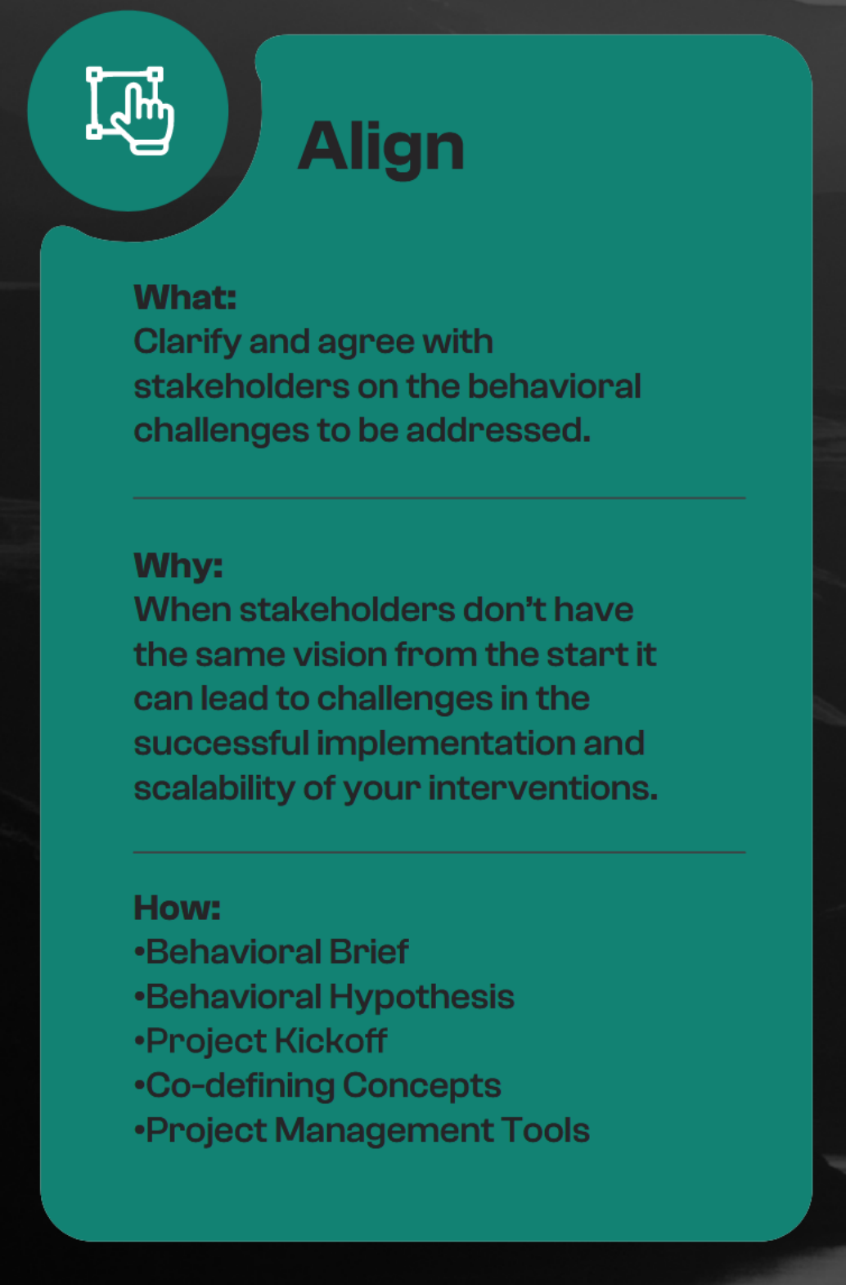
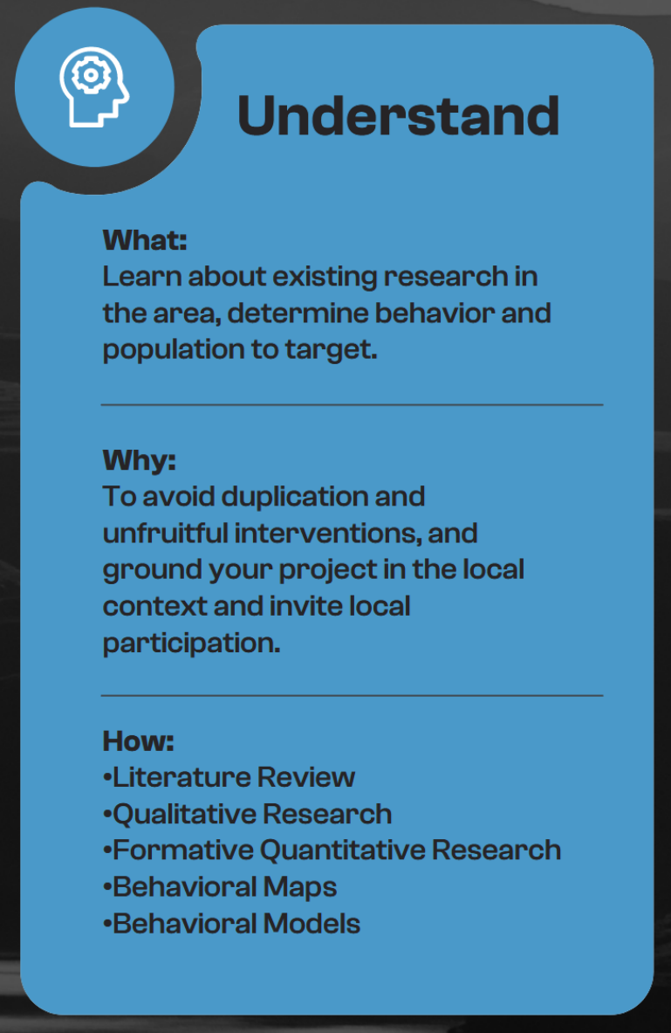
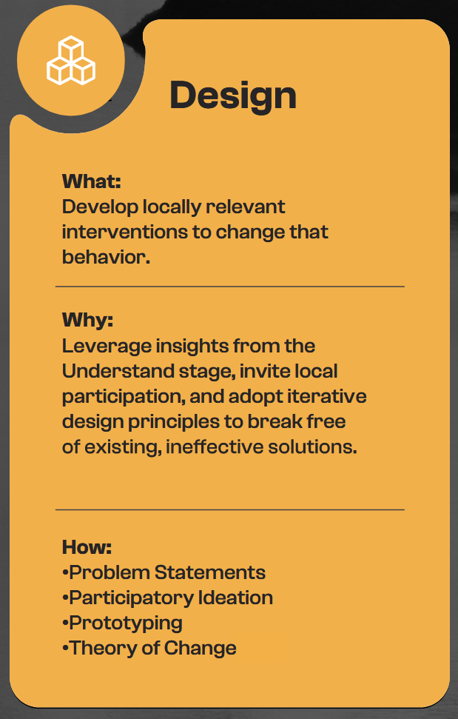
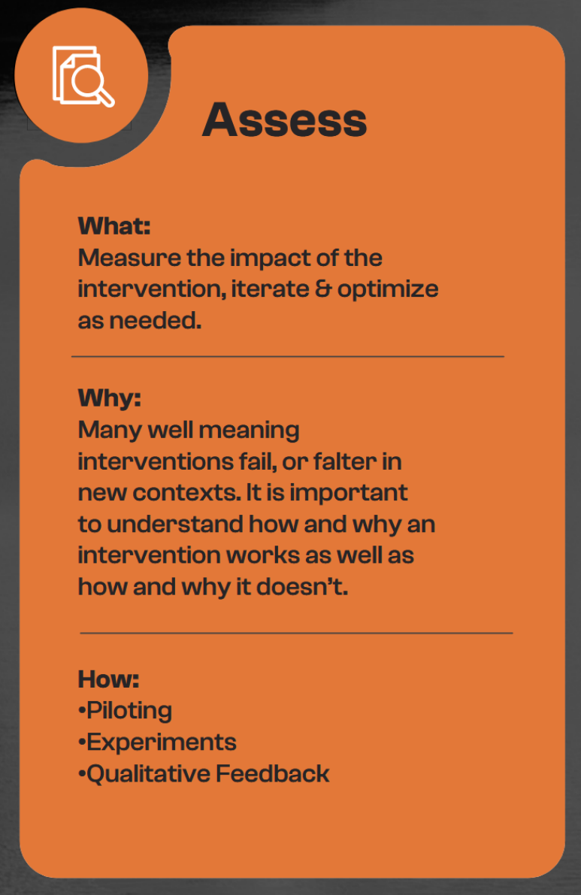
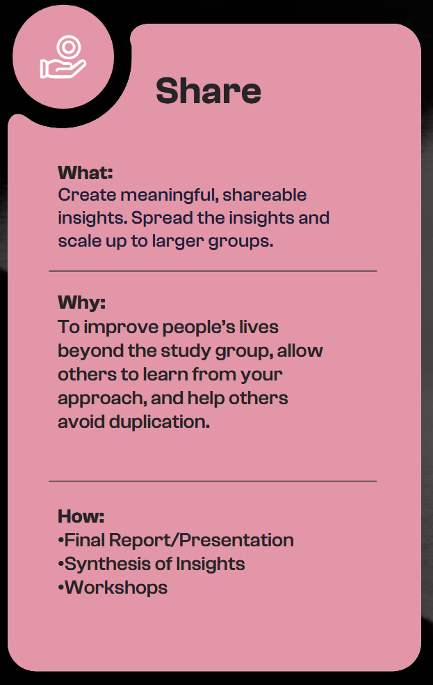
The AUDAS Model: Recap

Slide 36
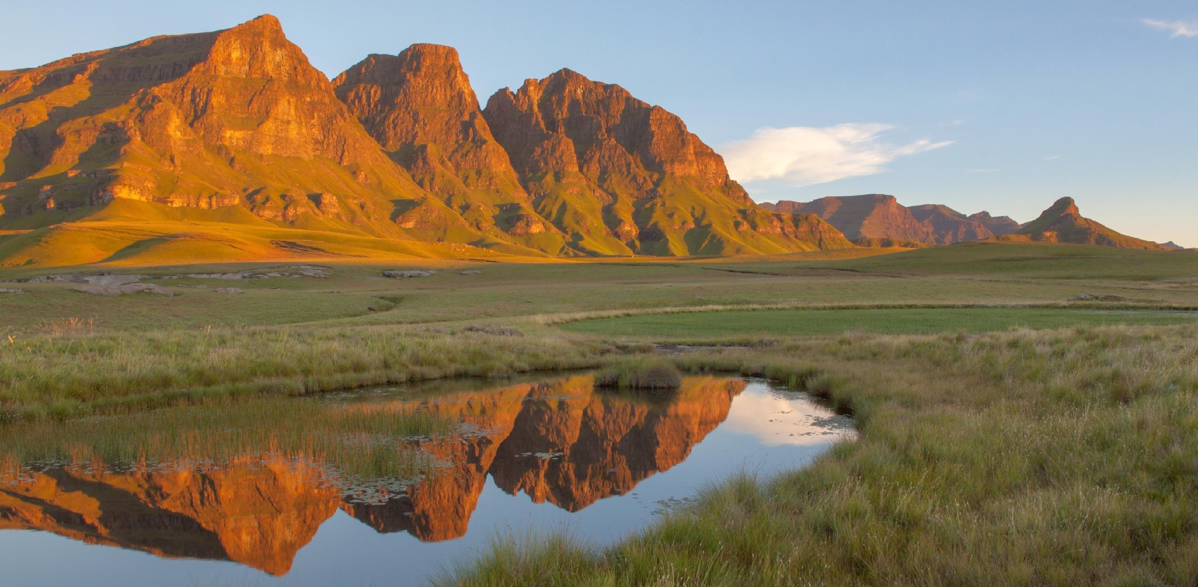
Our Problem Statements
What were the key behavioral problems we wanted to solve?

Slide 37




After our in-depth research, we focused on four main problem statements:
Community members need to see the benefit of collaborating and working together
To reduce incidences of vandalism by targeting anti-social behaviours
To increase adoption of favourable agricultural practices in order to reduce soil erosion
To increase adoption of better grazing practices by animal owners and herders to reduce soil erosion

Slide 38
In order to achieve these goals, we prioritised our approach through corresponding How Might We statements:
Community members need to see the benefit of collaborating and working together
To reduce incidences of vandalism by targeting anti-social behaviours
To increase adoption of favourable agricultural practices in order to reduce soil erosion
To increase adoption of better grazing practices by animal owners and herders to reduce soil erosion
How might we foster cooperation among community members by showcasing the benefits of working together for sustainable rangeland management practices?
How might we frame water infrastructure as a shared resource that each community member owns and is responsible for?
How might we promote practice for sustainable farming? How might we share technical information about sustainable practices with farmers for them to see its benefits and adopt them?
How might we encourage animal owners and herders to adopt sustainable rangeland management practices?

Slide 39
Going from prototypes to pilots
Following a prototyping phase in which we tested around 13 prototypes (an average of 3 per problem statement) we realized that the first two statements around cooperation and vandalism had similar behavioral mechanisms and outcomes could feed into each other – thus leading to us combining these goals.

Slide 40
Study Findings &
Recommendations
Vandalism and Cooperation (Inter-Community Cohesion)

Slide 41
Our Approach
Main Issues
Poor land management practices were made worse by weak cooperation within communities.
Antisocial acts like vandalism and theft in neighboring communities were routine.
Identified Behavioral Science Approaches
Experiencing a strong sense of commonality with one’s community, and feeling close and connected to others in neighbouring communities.
Embracing the responsibility to protect natural resources as a goal and feeling a sense of ownership of these resources.
Expecting fellow community members to take actions to conserve shared land.
Experiment Design
Treatment group: 20 villages receiving the intervention and subsequent surveys.
Control group: Another 20 villages not receiving the intervention but still surveyed.
Intervention Design
Audio narration of an adapted Basotho folklore tale emphasizing closeness and commonality.
Interactive activities like a skit and group games aimed at fostering collective participation.

Slide 42
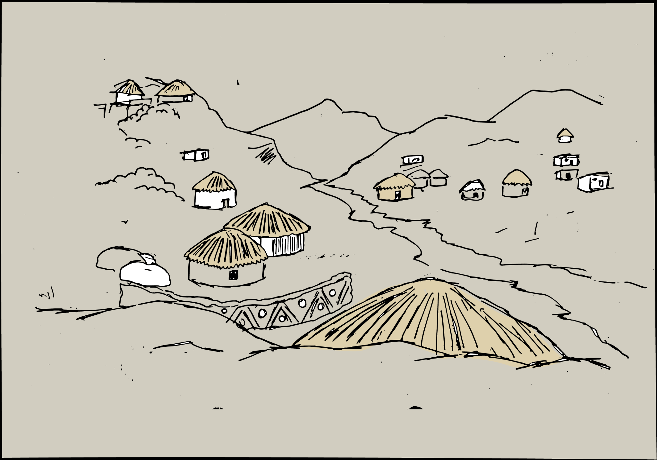
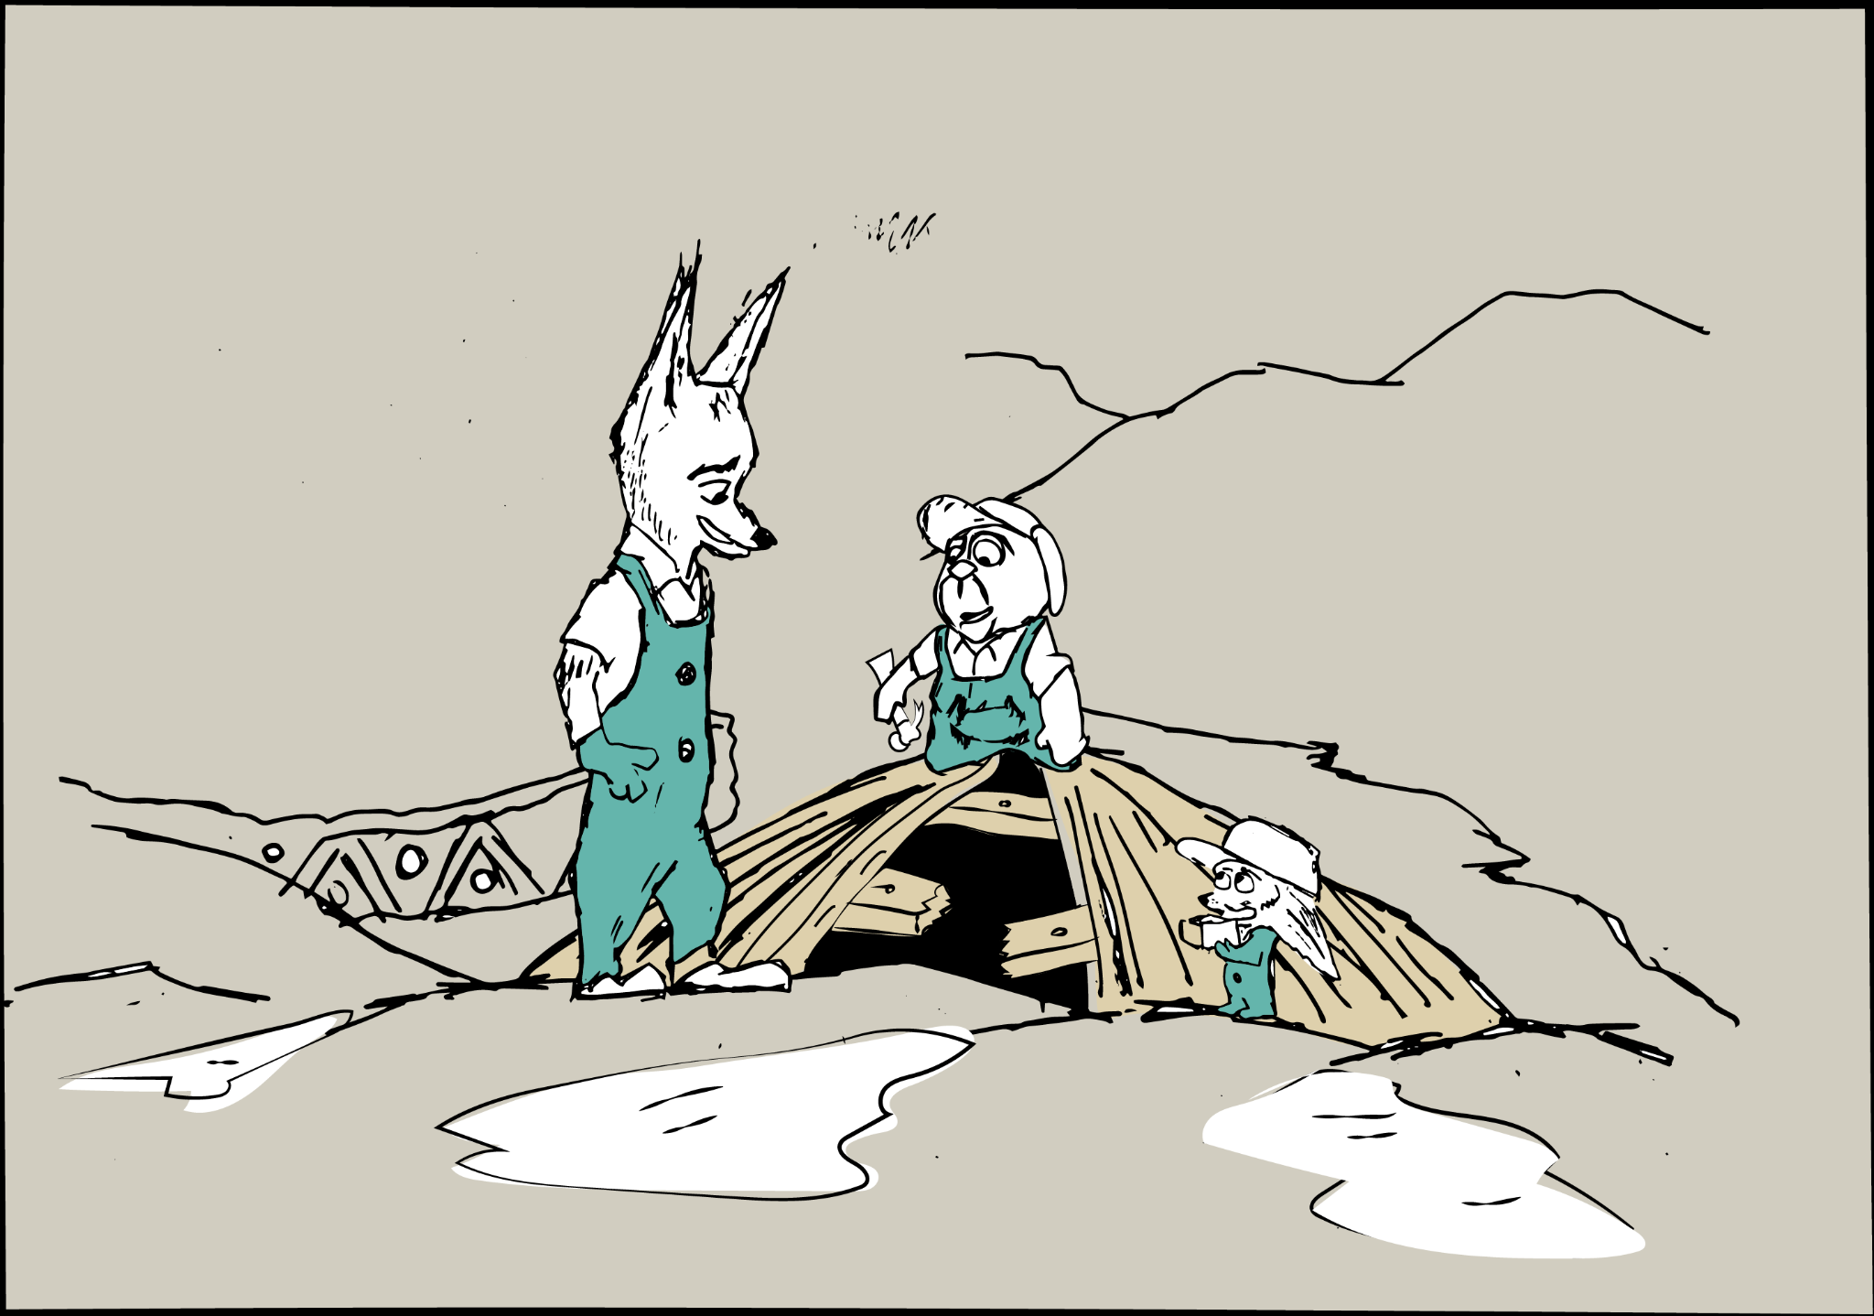
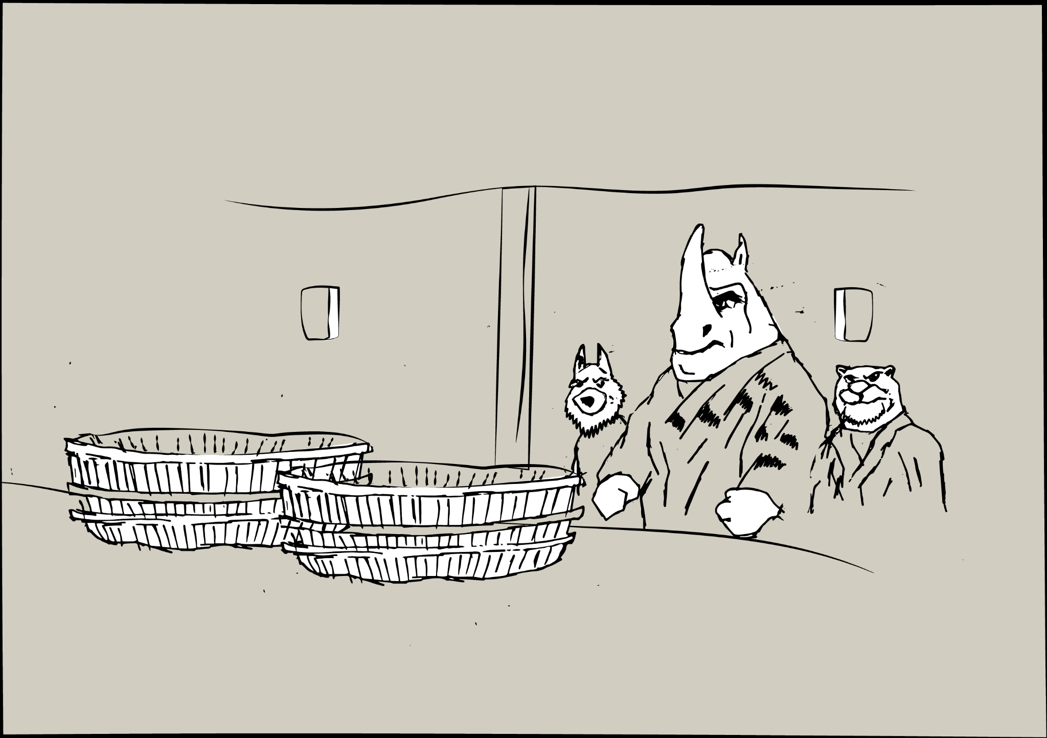
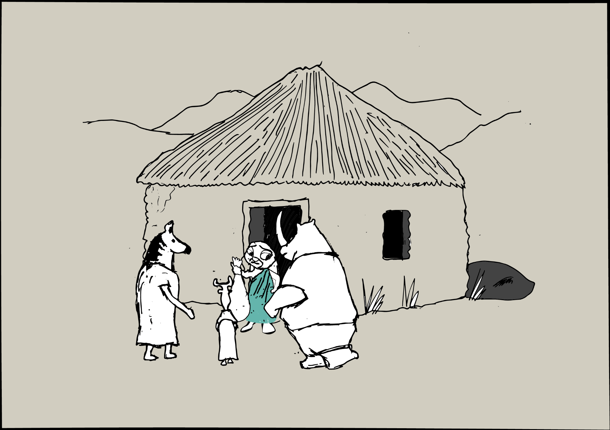
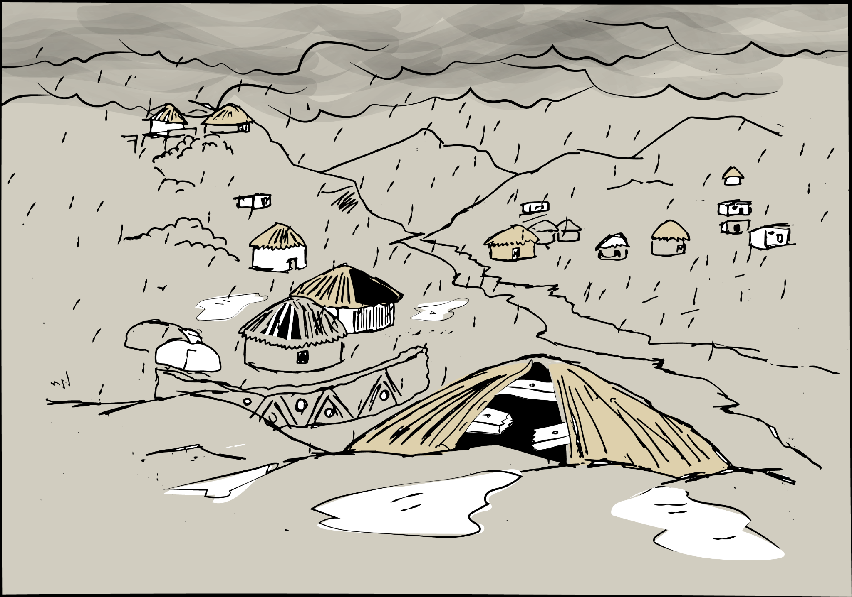
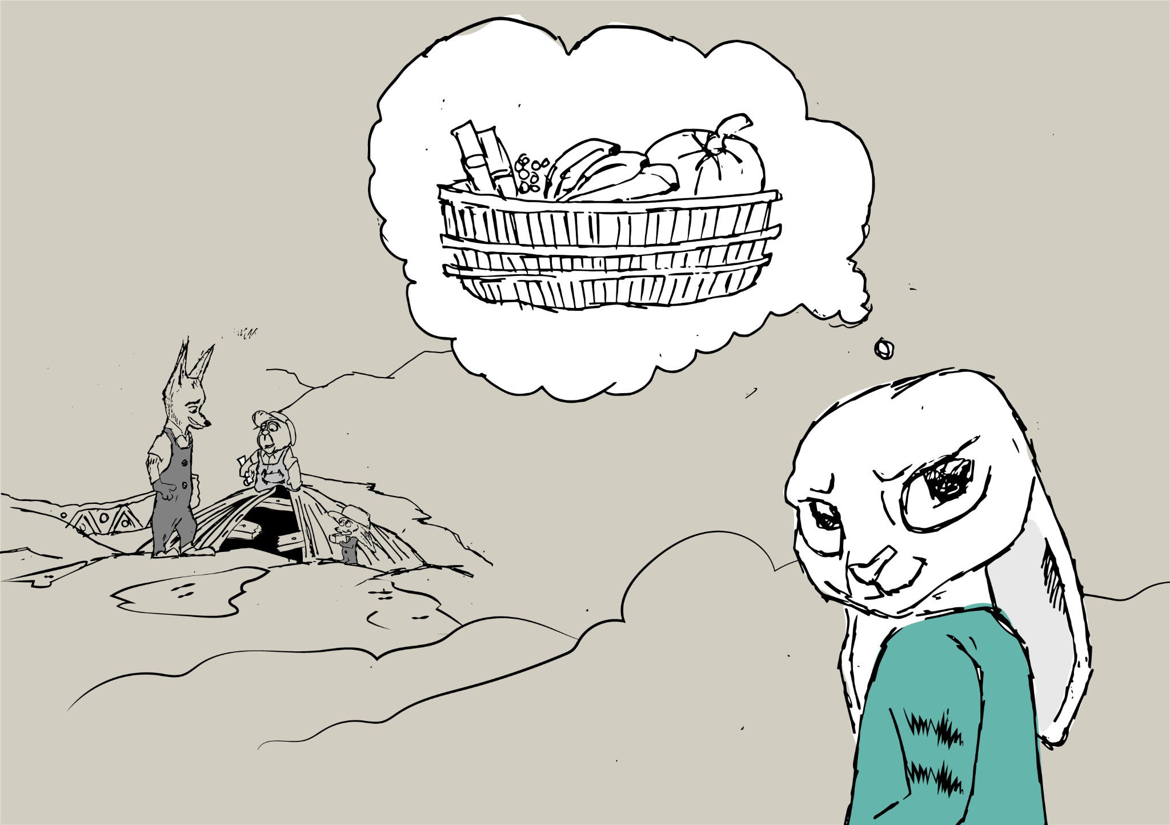
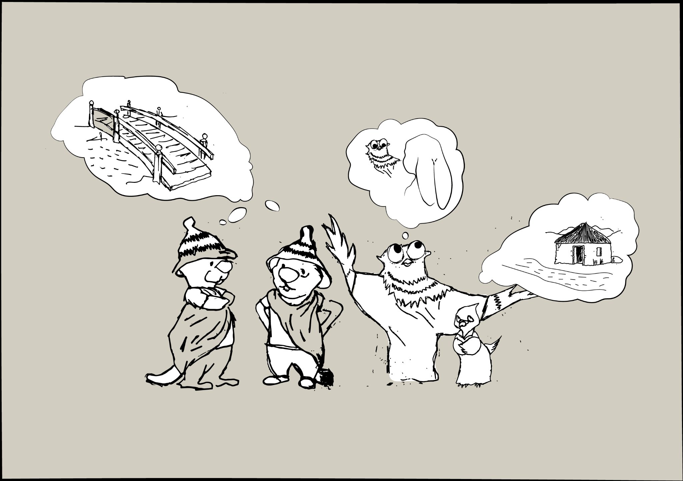
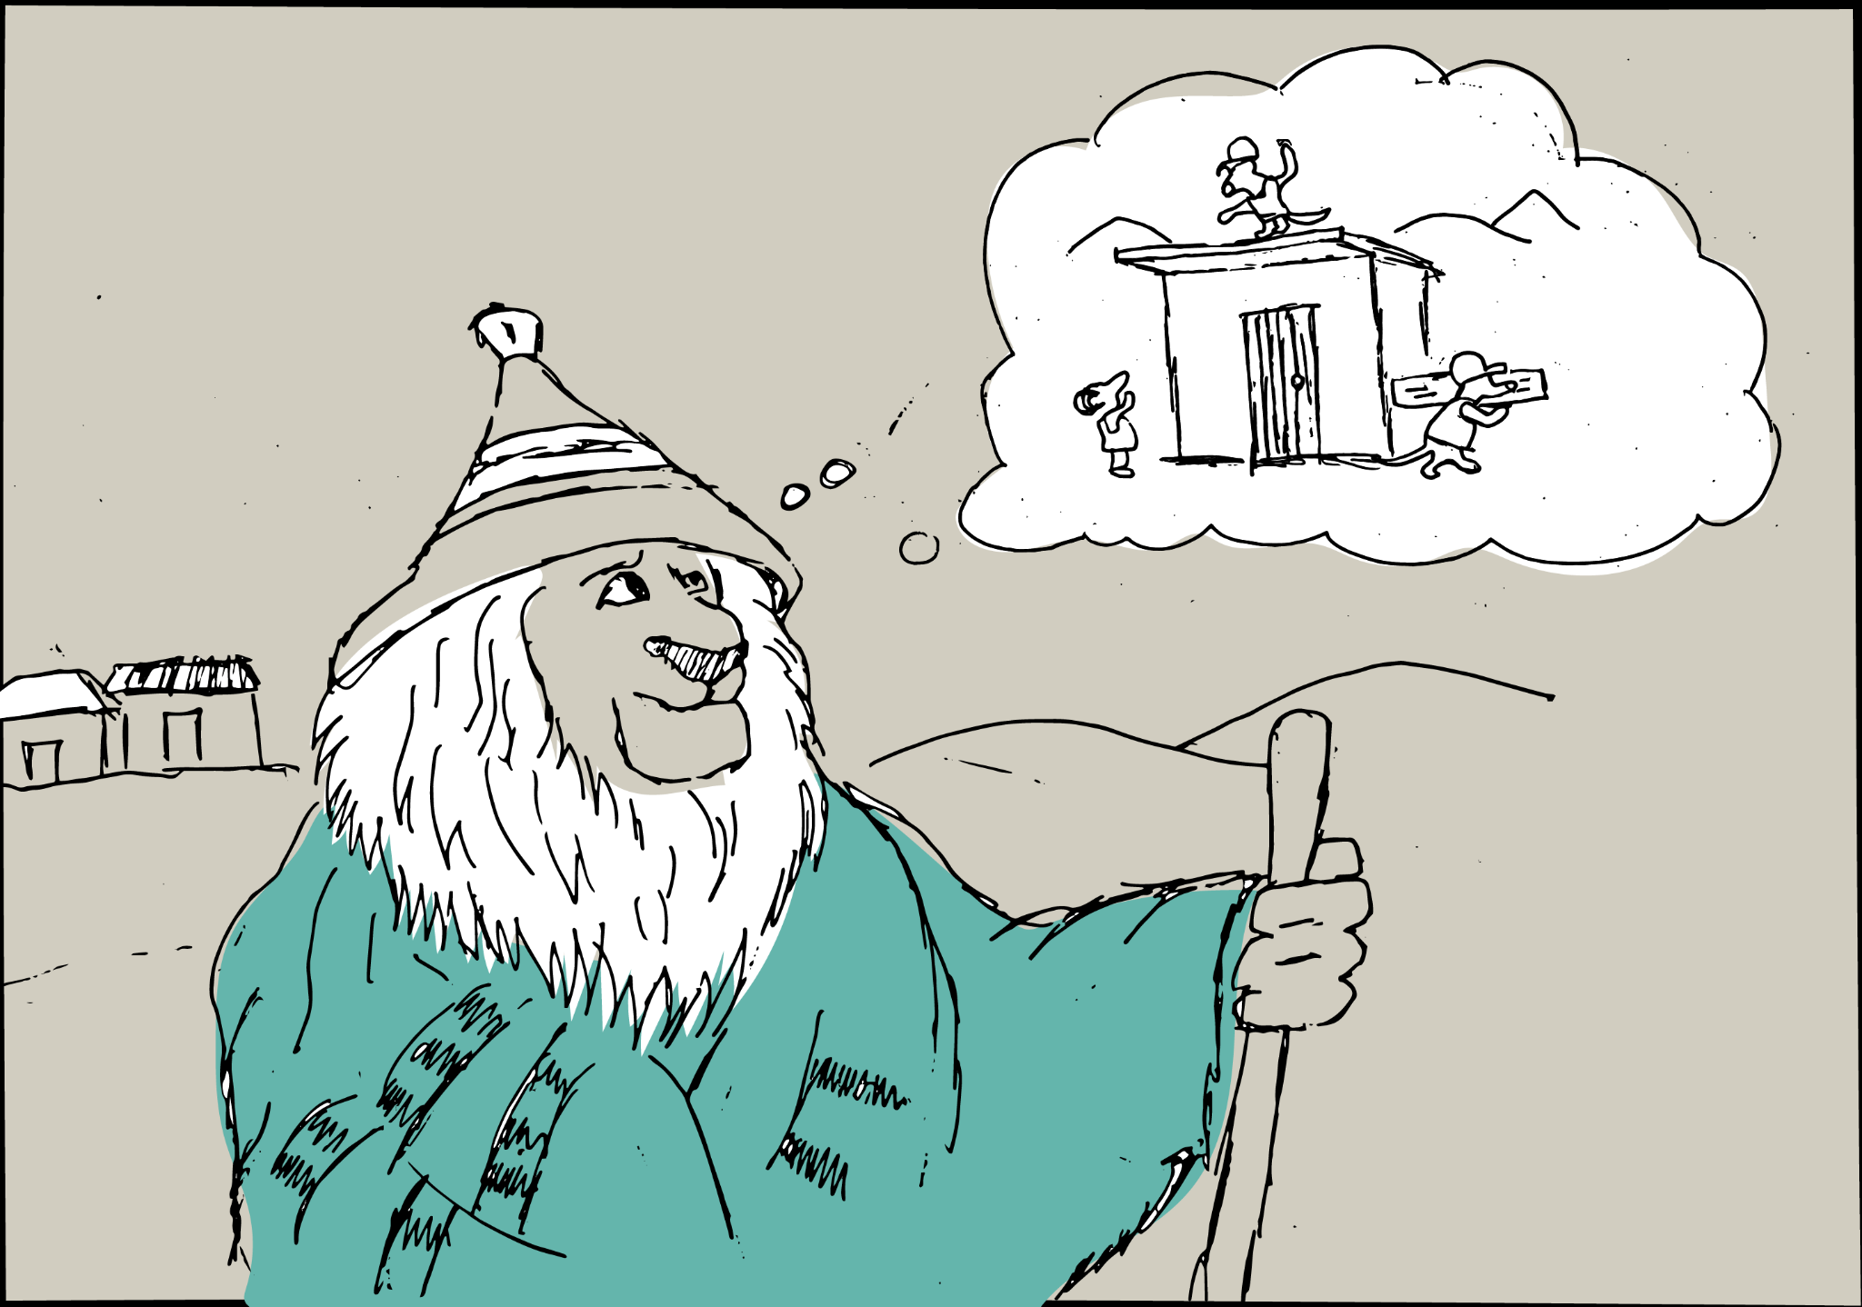
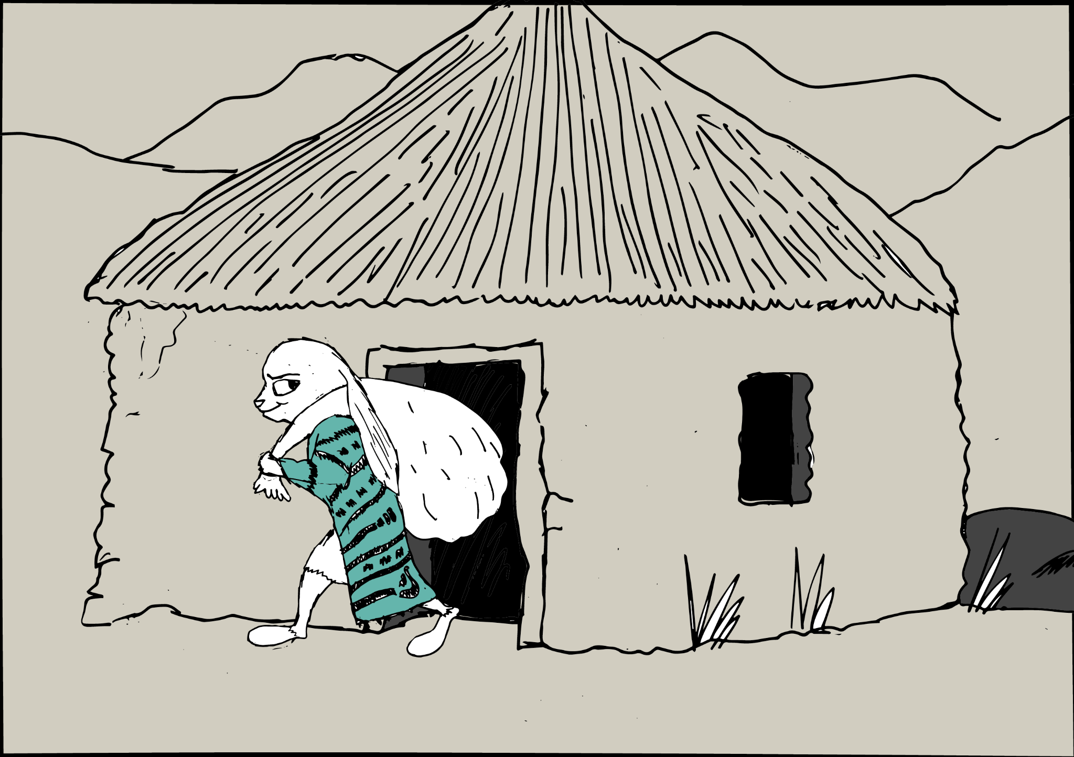
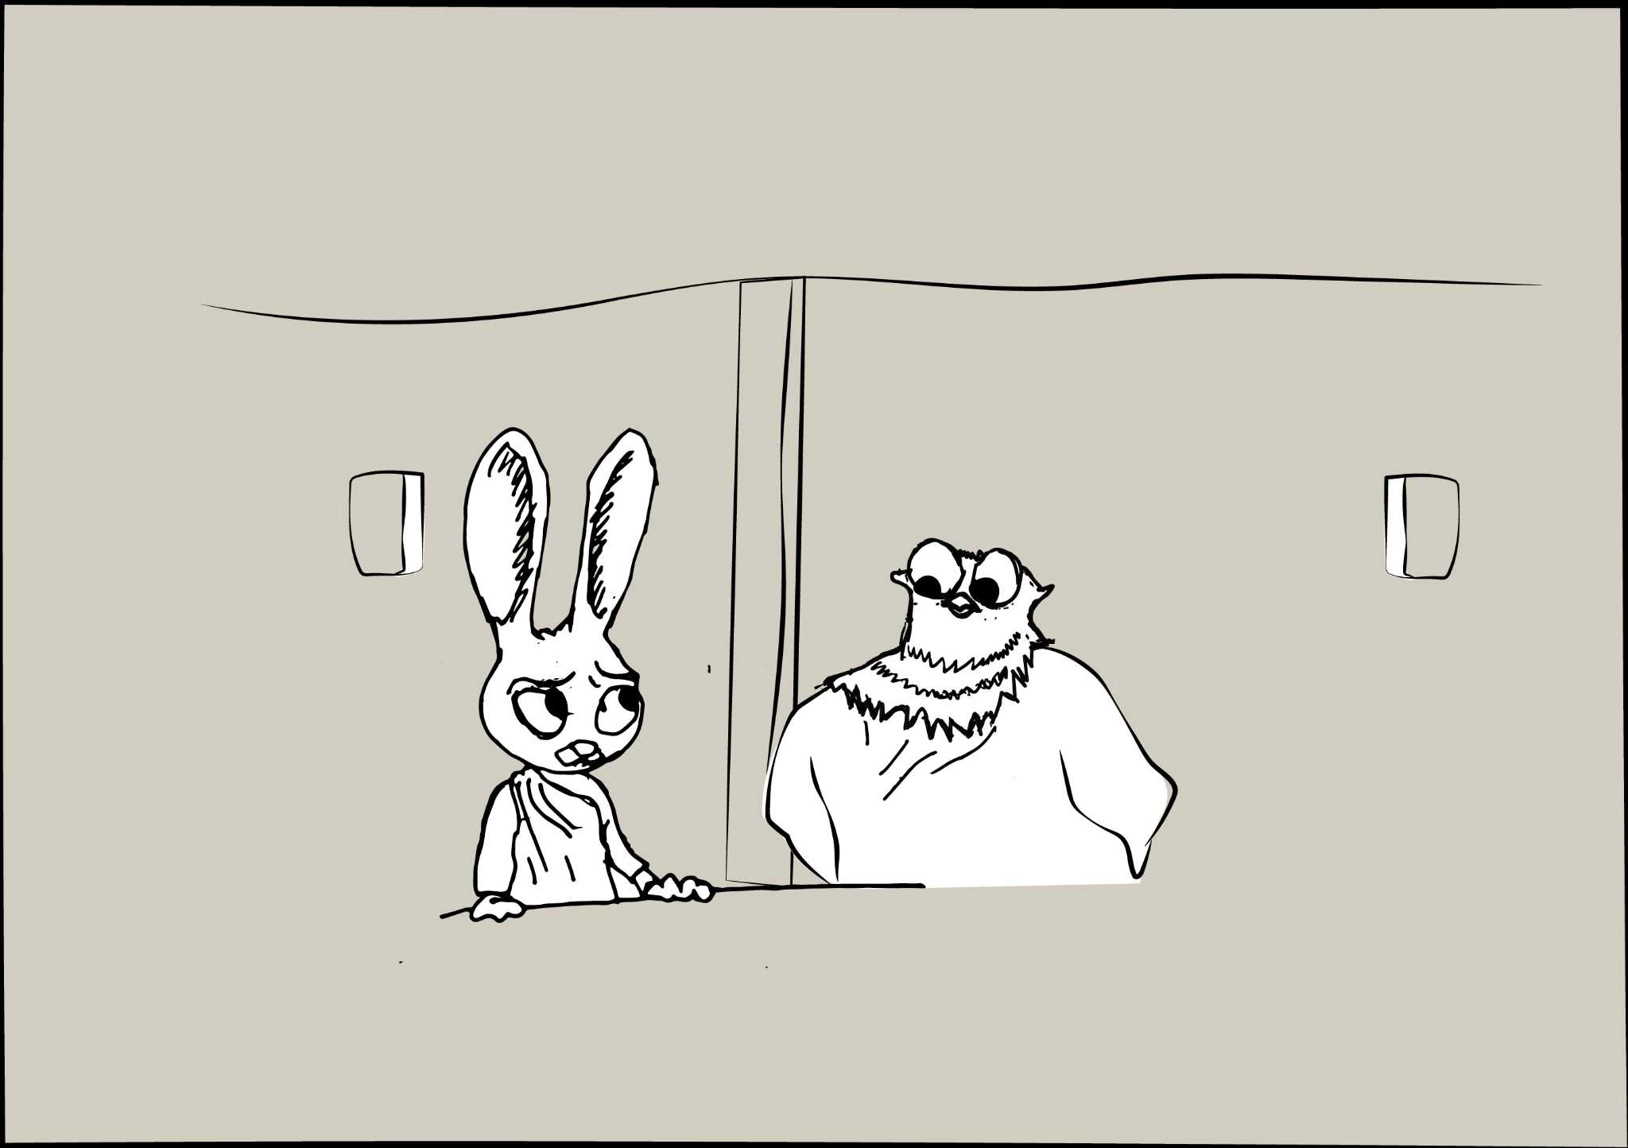
Audio
Problem Statement 1
How might we promote sustainable practices amongst farmers?
Click to play
FOLKLORE STORY
The adaptation of a Basotho folklore tale was told via an audio recording that was presented with the illustrations to serve as a visual of the story to depict the importance of cooperation and protection of community owned spaces in a localized and relatable manner.
Notes:
Once upon a time, near a river, many different communities lived together. One day, a storm came and destroyed many of their homes from the different communities, leaving some without roofs over their heads and their belongings exposed to the rain. They were upset and worried, but they didn't know how to fix their homes.
As they were trying to figure out what to do, suddenly the smart and hardworking Moshoeshoe, [the lion] came up with a plan. He proposed that all the people work together to rebuild the homes within the different communities. Each person and community would contribute in their own way - some would gather wood, some would carry water, some would make tools, and others would provide food and support. Everyone would work towards a common goal, and no one would be left behind.
Everyone from the different communities agreed and started working together. They worked hard for many days and nights, using their individual strengths to make a stronger, more resilient community. They laughed, sang, and shared meals as they worked, happy in the knowledge that they were doing God’s work and protecting the lands that God created, together.
However, one person, Thabo, [the hare], didn't want to work hard like the others. He was the village representative for the community by the river, and he had been observing the others. He saw that they were working hard, and he knew he could take advantage of the situation. One day, when the rest were out working, Thabo sneaked into their homes and stole all their food and belongings. He hid them in his own community across the river and enjoyed them alone.
When the others returned, they were devastated. They felt betrayed and angry that someone would do such a thing. But they didn't give up. They all thought of a plan together to confront Thabo. First, Nthatisi, [the sparrow], would watch to see what time Thabo got back home. Then, Tumo and Tumelo, [the beavers], would build a bridge across the river bank so everyone could travel to see Thabo. Then, Naledi, [the owl], would explain the importance of community and the fact that protecting the land was something they could do together, and that protecting the community would be a way to give back to God as thanks for his generosity.
Finally, Naledi would ask Thabo to return the belongings.
In the end, the animals succeeded. They got back their belongings, and Thabo understood that working together and contributing to the community was better than stealing and selfishness. Thabo told everyone in his community of the pact that all the communities had to work together, and they wanted to join in the pact too. The people went on to live in a more harmonious and resilient community, looking out for each other and making sure that no one was left behind.

Slide 43

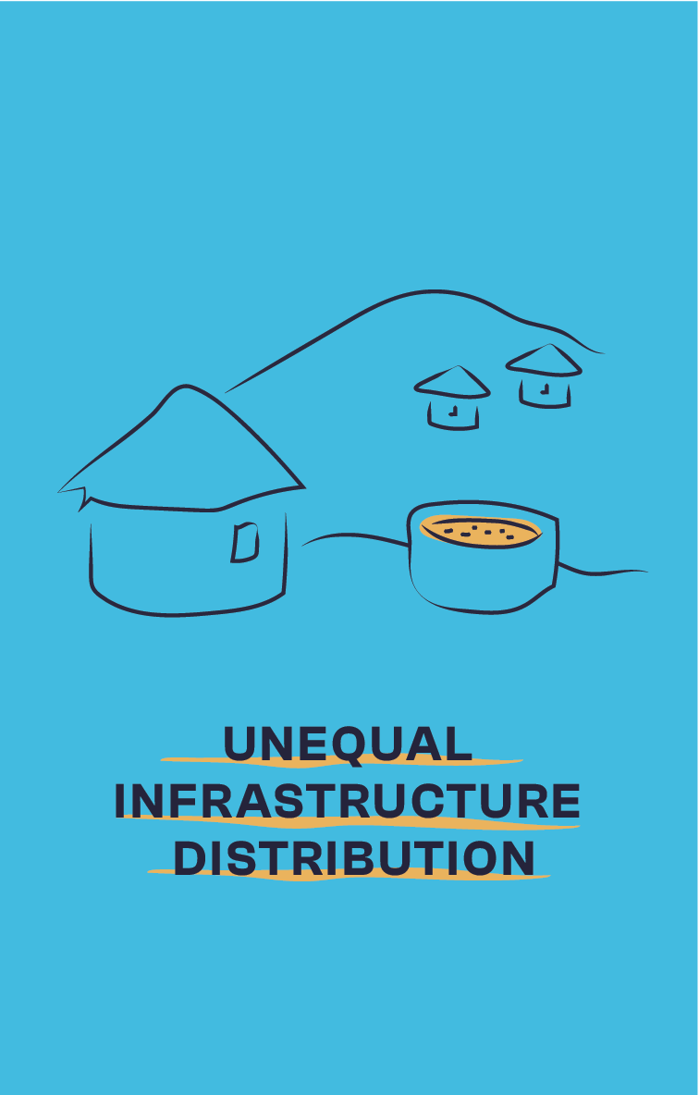
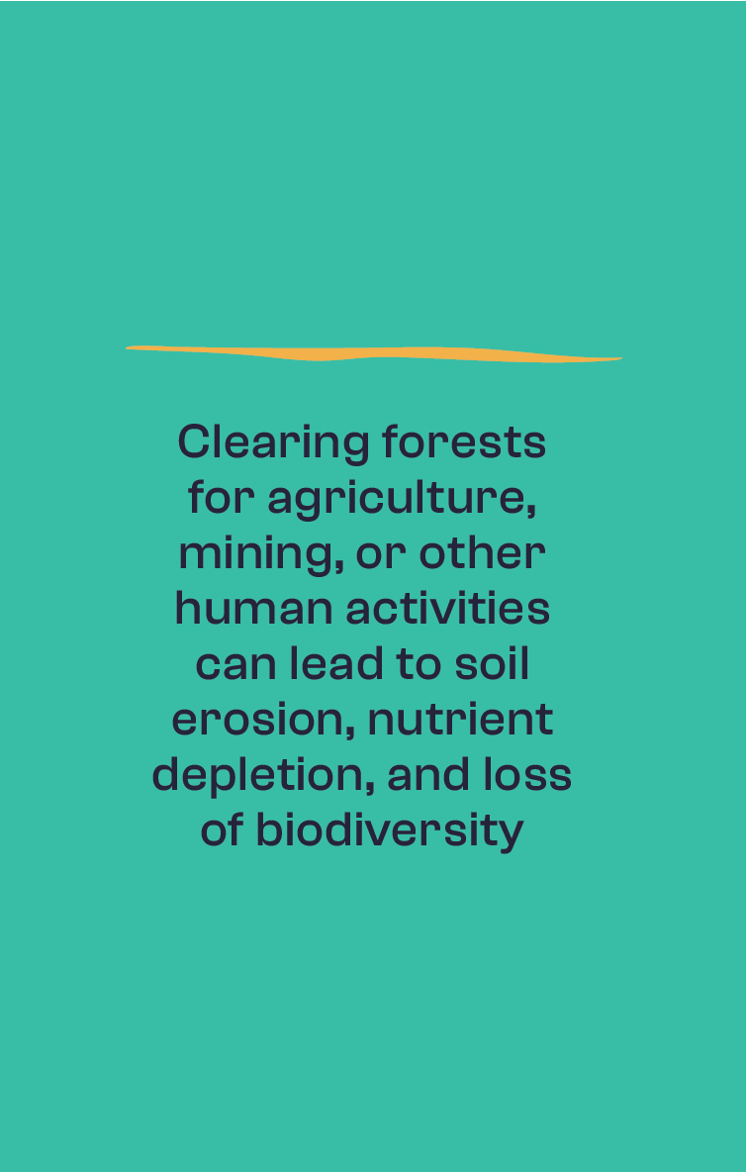
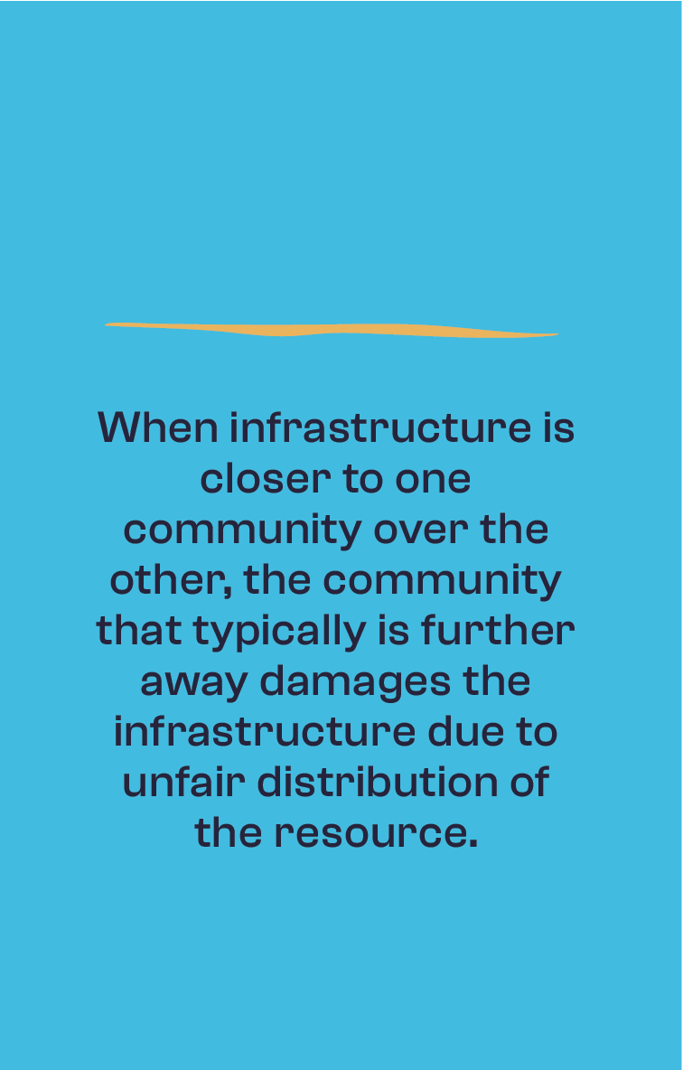
Problem Statement 1
How might we promote sustainable practices amongst farmers?
LAND DEGRADATION PROTOTYPES
The cause and effect card sorting game clarifies an understanding of the cause and effect of degrading land and the destruction of infrastructure on community livelihood and frames these effects as immediate and personal.

Slide 44
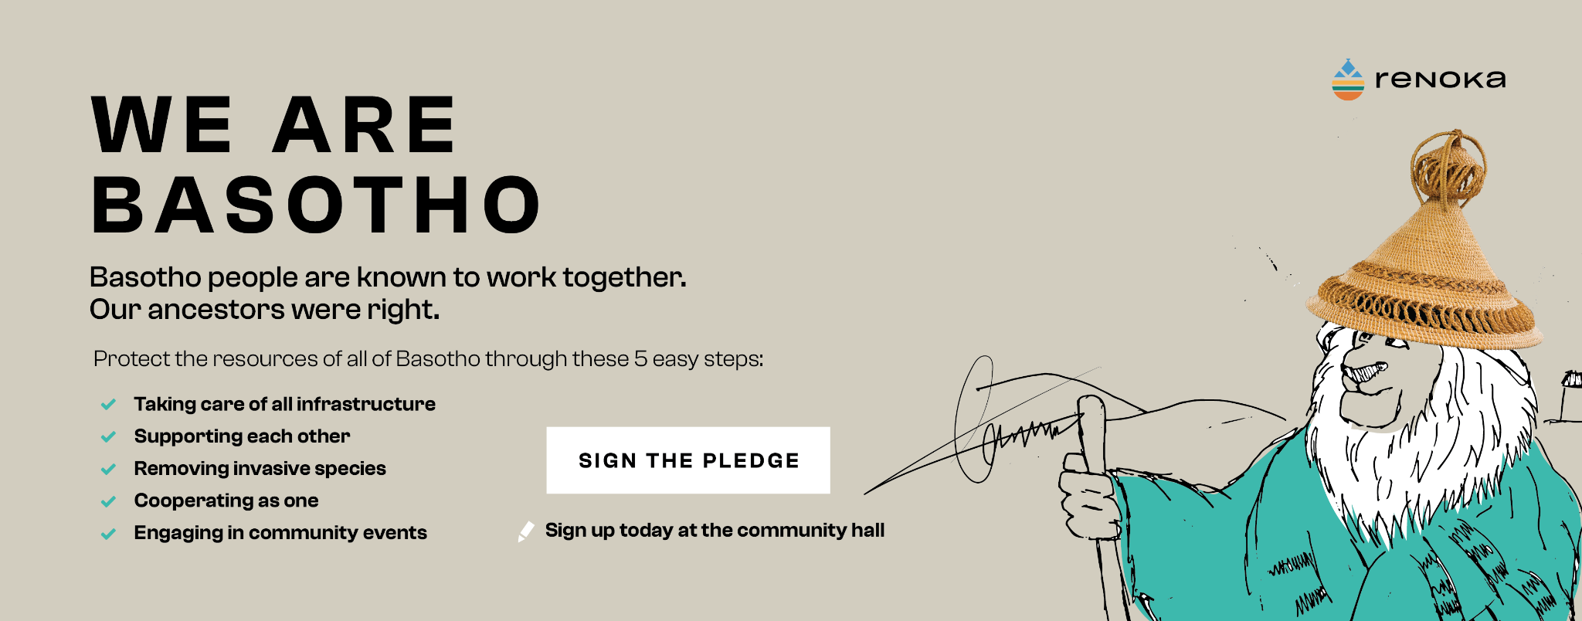
Problem Statement 1
How might we promote sustainable practices amongst farmers?
PLEDGE POSTER
The pledge refers back to a shared identity of Basotho people and is framed to as both a commitment towards the infrastructure and to prevent the land from degrading. This also ties back to the folklore tale to imply the benefits of cooperation. Participants signed this and placed it in a public space to serve as a reminder of their public commitment.

Slide 45
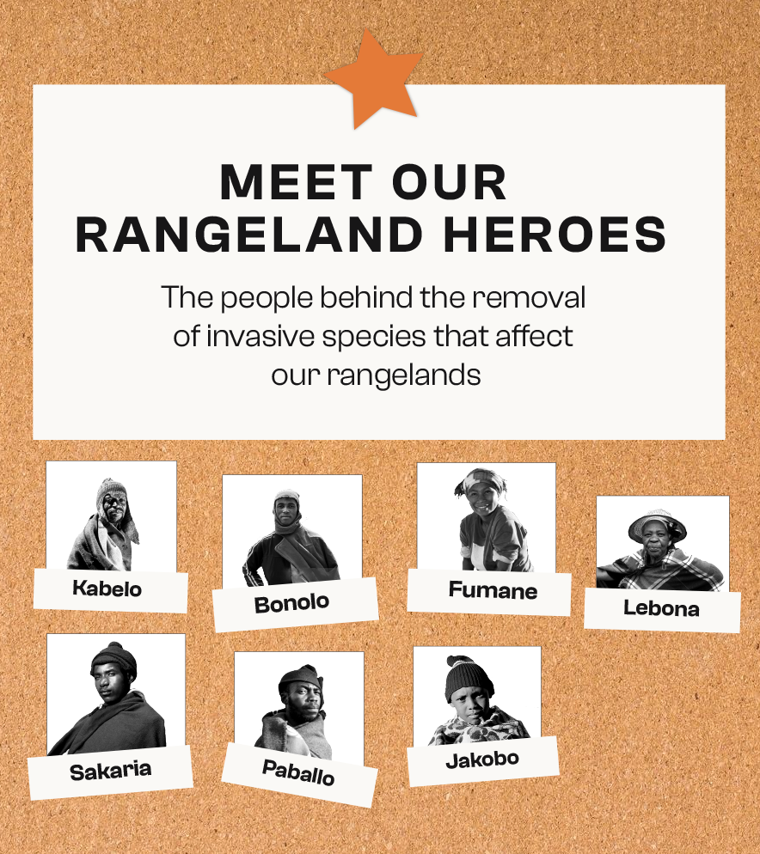
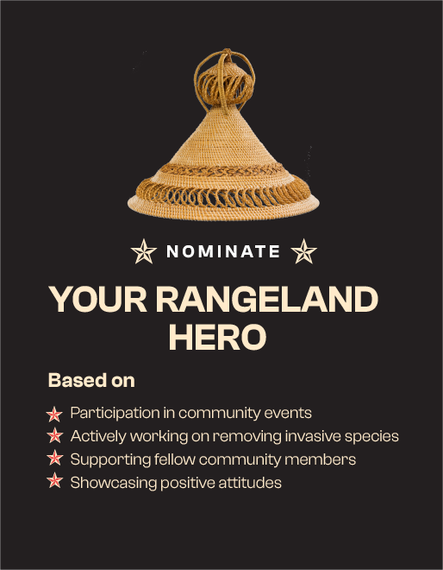
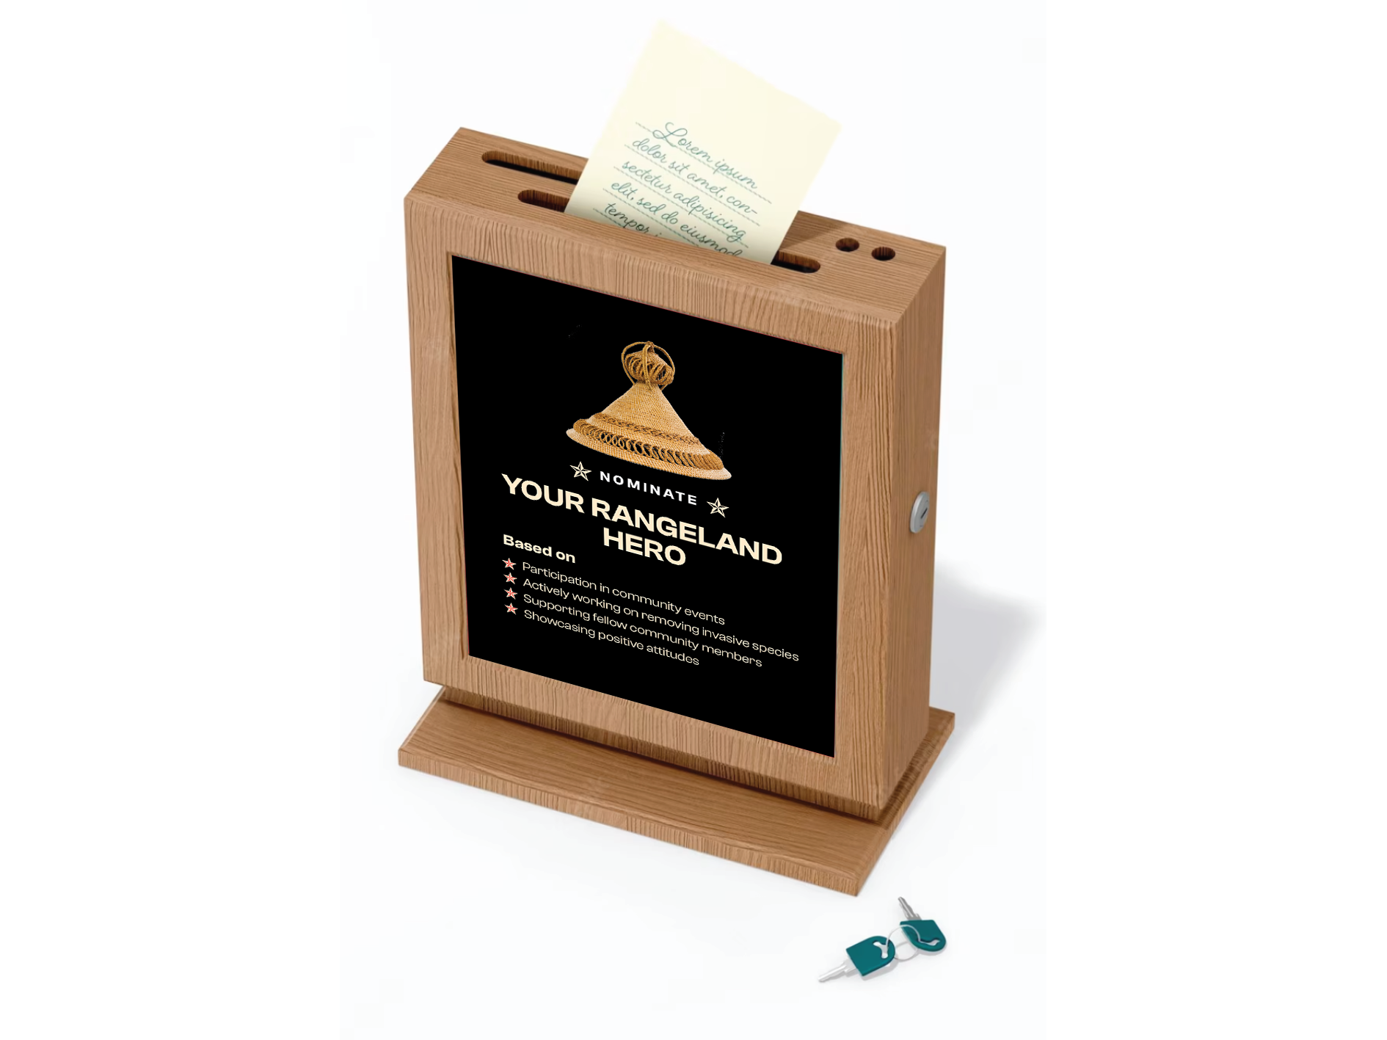
Problem Statement 1
How might we promote sustainable practices amongst farmers?
COMMUNITY RECOGNITION VOTING
This activity involved community members being nominated by fellow community members or chiefs to have their photo or name on a ‘wall of fame’ (public wall in community) to be recognized for their efforts in community led initiatives.

Slide 46
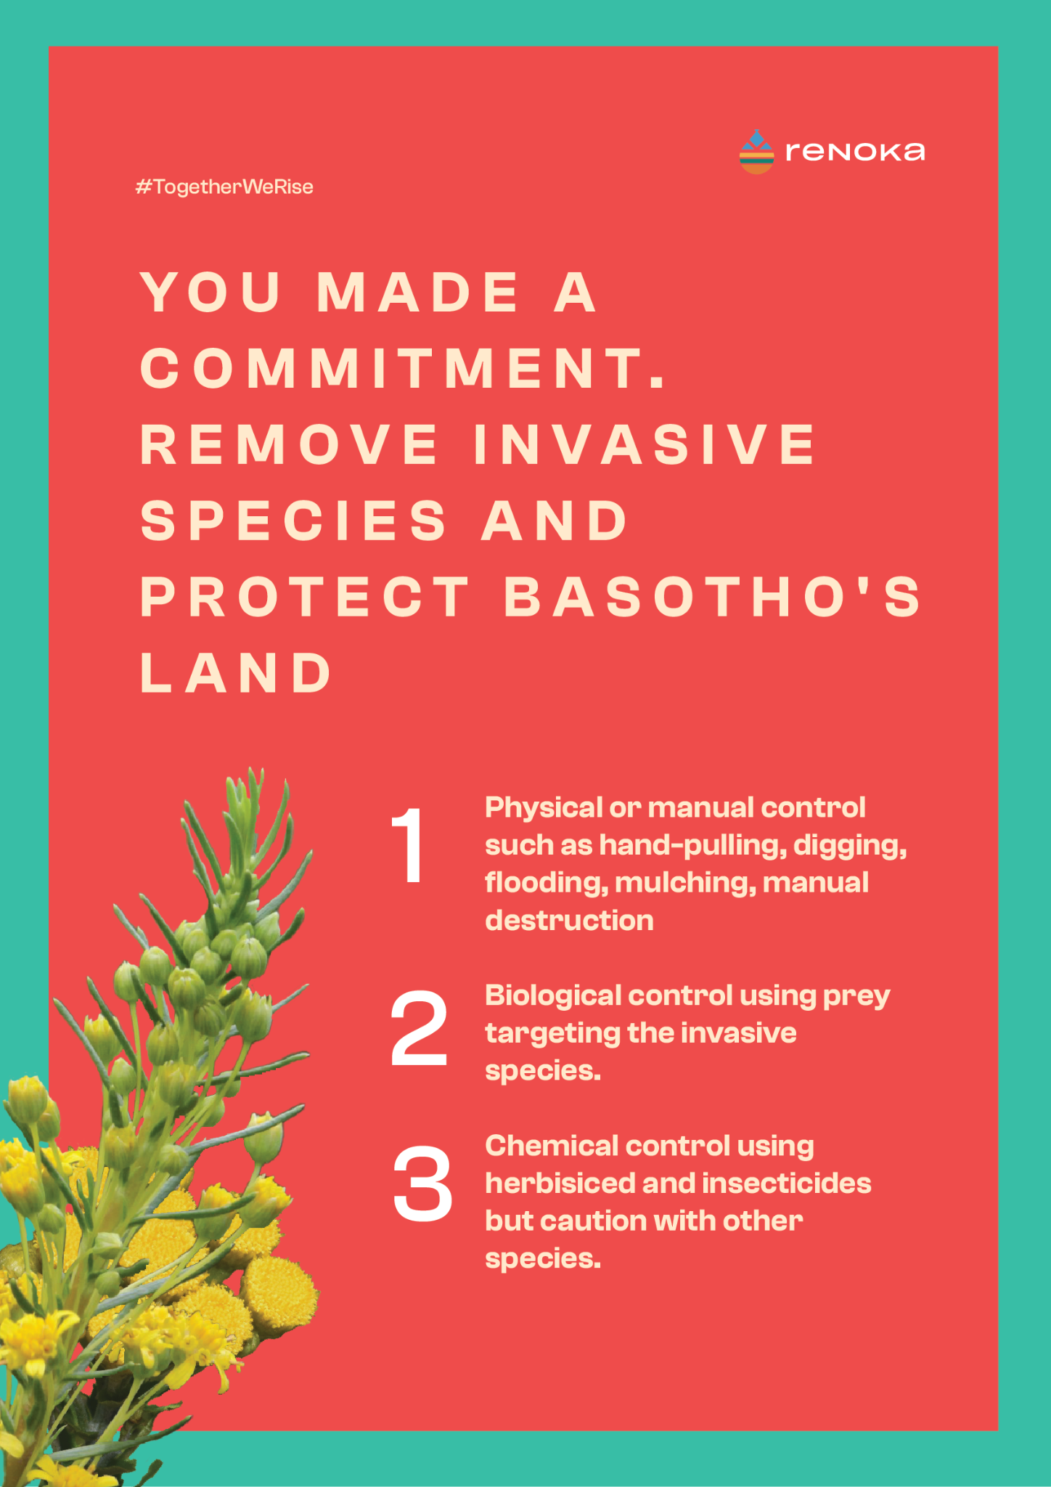
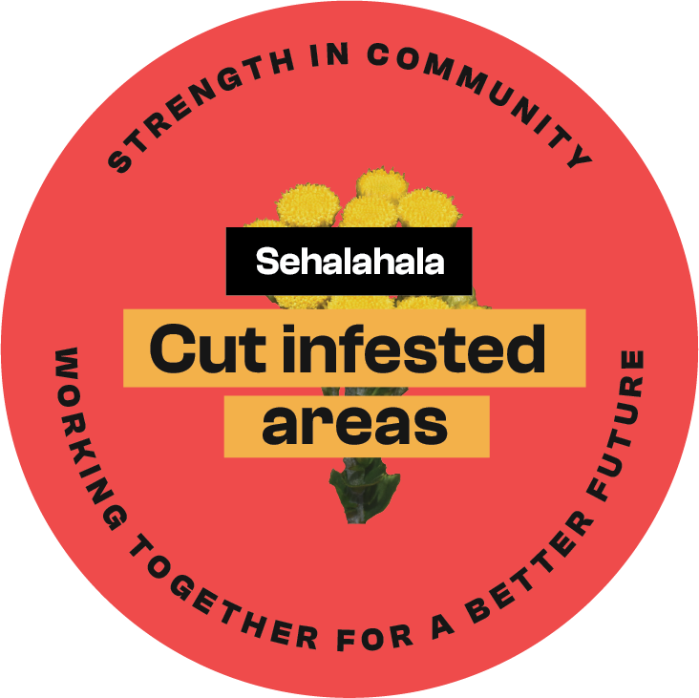

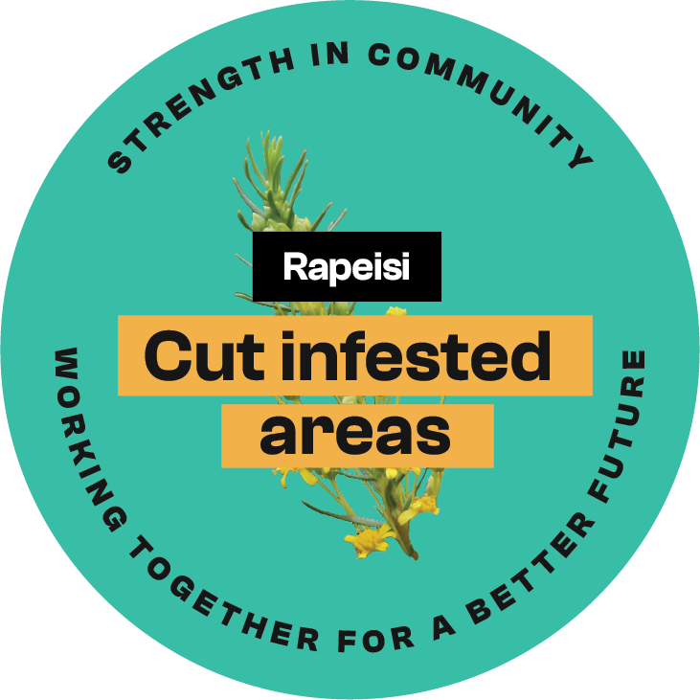
Problem Statement 1
How might we promote sustainable practices amongst farmers?
INVASIVE SPECIES POSTER AND STICKERS
The poster serves as a reminder of their commitment to protect shared land. The stickers were a part of our survey activity to serve as visual reminders and highlight the importance of cooperation.

Slide 47
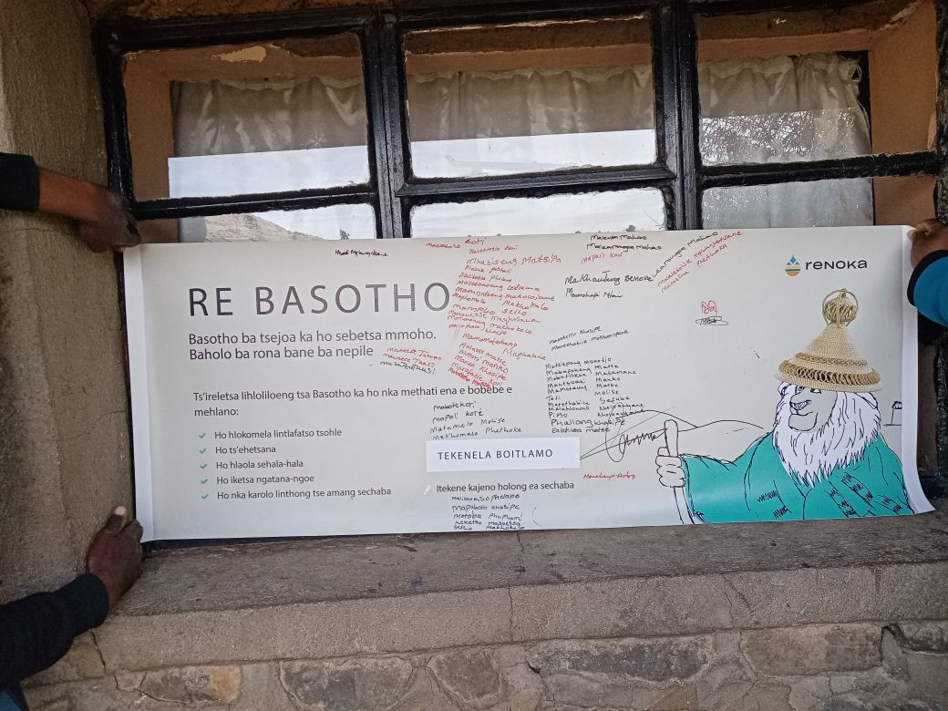
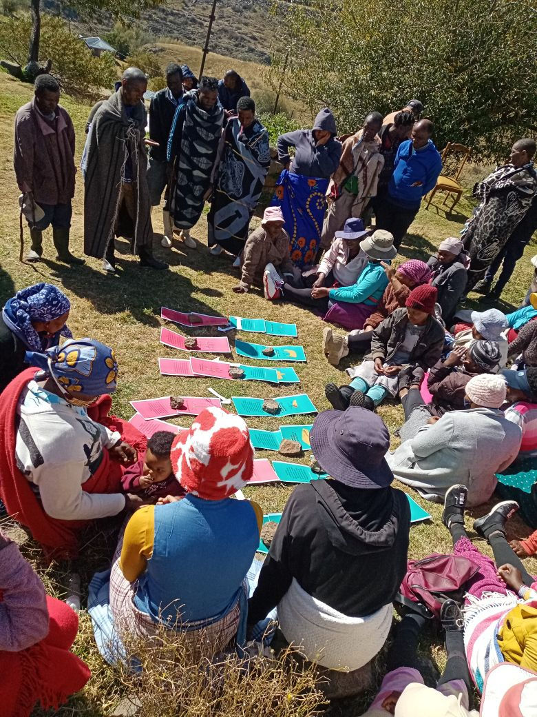
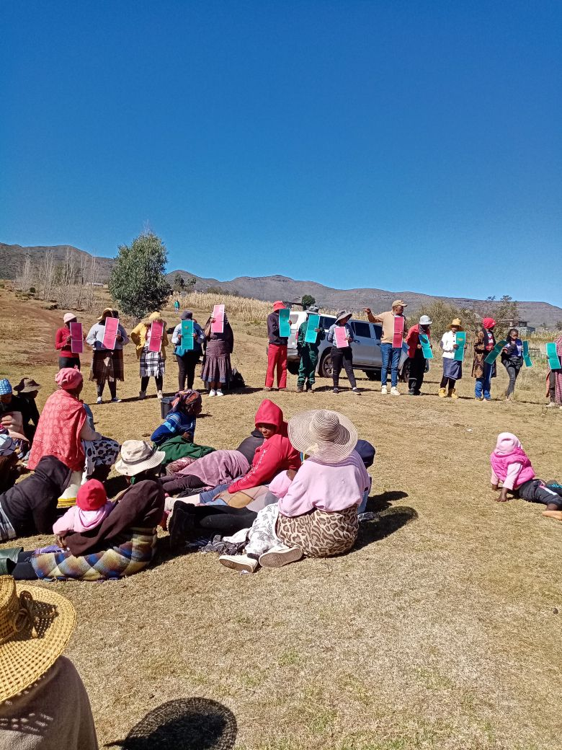
Problem Statement 1
How might we promote sustainable practices amongst farmers?
FROM THE FIELD

Slide 48
Findings
Treatment and control groups had similar intentions but low actual participation: Over 95% of all community members expressed a desire to volunteer in community activities. However, actual participation in an activity removing invasive species was low revealing a gap between intentions and action
Intervention effect on inter-community cohesion: The intervention had a positive effect on promoting inter-community cohesion or willingness to contribute to neighboring communities. Individuals from treatment villages were more inclined to perform the a costly (time-consuming) again if it meant helping adjacent villages.
Preference for cash incentives: Interviews revealed that participants are accustomed to cash rewards, and the lack of such incentives likely reduced motivation to engage in follow-up activities.

Slide 49
Recommendation 1A
Promote a sense of commonality: While the study didn’t increase feelings of commonality, those with a stronger sense of connection to their village were more likely to volunteer. Similarly, those with a sense of connection to other villages were more likely to discourage vandalism.
Recommendation: We recommend interventions that focus on fostering intergroup ‘contact’:
Cross-community events that can take the form of joint goal-setting and conservation efforts (e.g. removing invasive species on land that is shared by multiple villages) and knowledge sharing (e.g. meetings to discuss common invasive species in the area and the proper methods of disposal).
These events should also include catchment managers and/or agricultural extension workers as co-facilitators.
In these events everyone should be treated equally and given equal chance to participate

Slide 50
Recommendation 1B
Tailor interventions to different age groups: Younger respondents prioritized discouraging vandalism even though they showed less interest in conservation than older respondents. This means young people are likely focused more on the social consequences of their actions.
Recommendation:
Emphasising the immediate social benefits of conservation and protection of resources (i.e. impact on community dynamics and well-being) for younger individuals
Highlighting the long-term ecological and economic benefits of conservation for older generations
Focusing on intergenerational consequences and impact on future generations can be an effective tactic for both younger and older individuals.

Slide 51
Recommendation 1C
Implementing feedback loops: Providing positive feedback on the community’s conservation efforts strengthens commitment to protecting resources and reducing vandalism. Demonstrating the direct impact of their actions is more effective than simply teaching sustainable behaviors.
Recommendation: We recommend a two-step process:
The first step can focus around telling a tangible success story, potentially with a visual or physical element that demonstrates positive impact
  An example of this first step could be to have a visual demonstration test showing nutrients in soil that was cleared from invasive species versus soil that was not cleared
The second step (less immediate) can focus on highlighting the community’s direct contribution to ICM in Lesotho

Slide 52
Recommendation 1D
Encourage intrinsic motivation against extrinsic incentives: Respondents often expect cash rewards, and the absence of these may have reduced participation in follow-up activities without incentives.
Recommendation: Use non-monetary incentives, like recognition or awards, to foster intrinsic motivation. Long-term, frequent engagement on specific topics can help sustain commitment and keep community members invested. Varying the content but maintaining the focus can be effective.

Slide 53
Thank you

